Slide 1

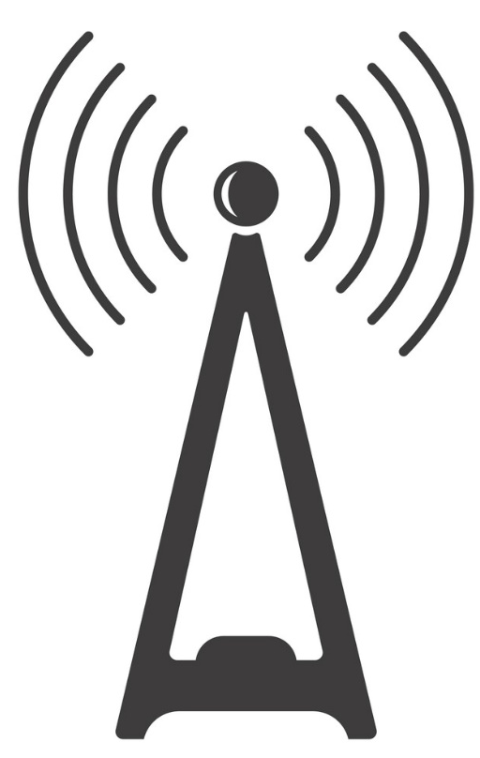
TOWN OF WESTLAKE COMMUNICATIONS TOWER UPDATE DECEMBER 19, 2022

Slide 2
Cell Tower
Vertical Bridge Contract approved in January 2022 by Town Council
Legal counsel has advised against placement of any cellular tower within ROW
SCADA, emergency services communication, Wi-Fi and other municipal uses
Pay the Town $12,000 per year for first two carriers' and will pay an additional $300 per month for each carrier thereafter
Require rezoning and a SUP for a wireless communications tower at the proposed
Presented to Planning & Zoning and Town Council in February

Slide 3
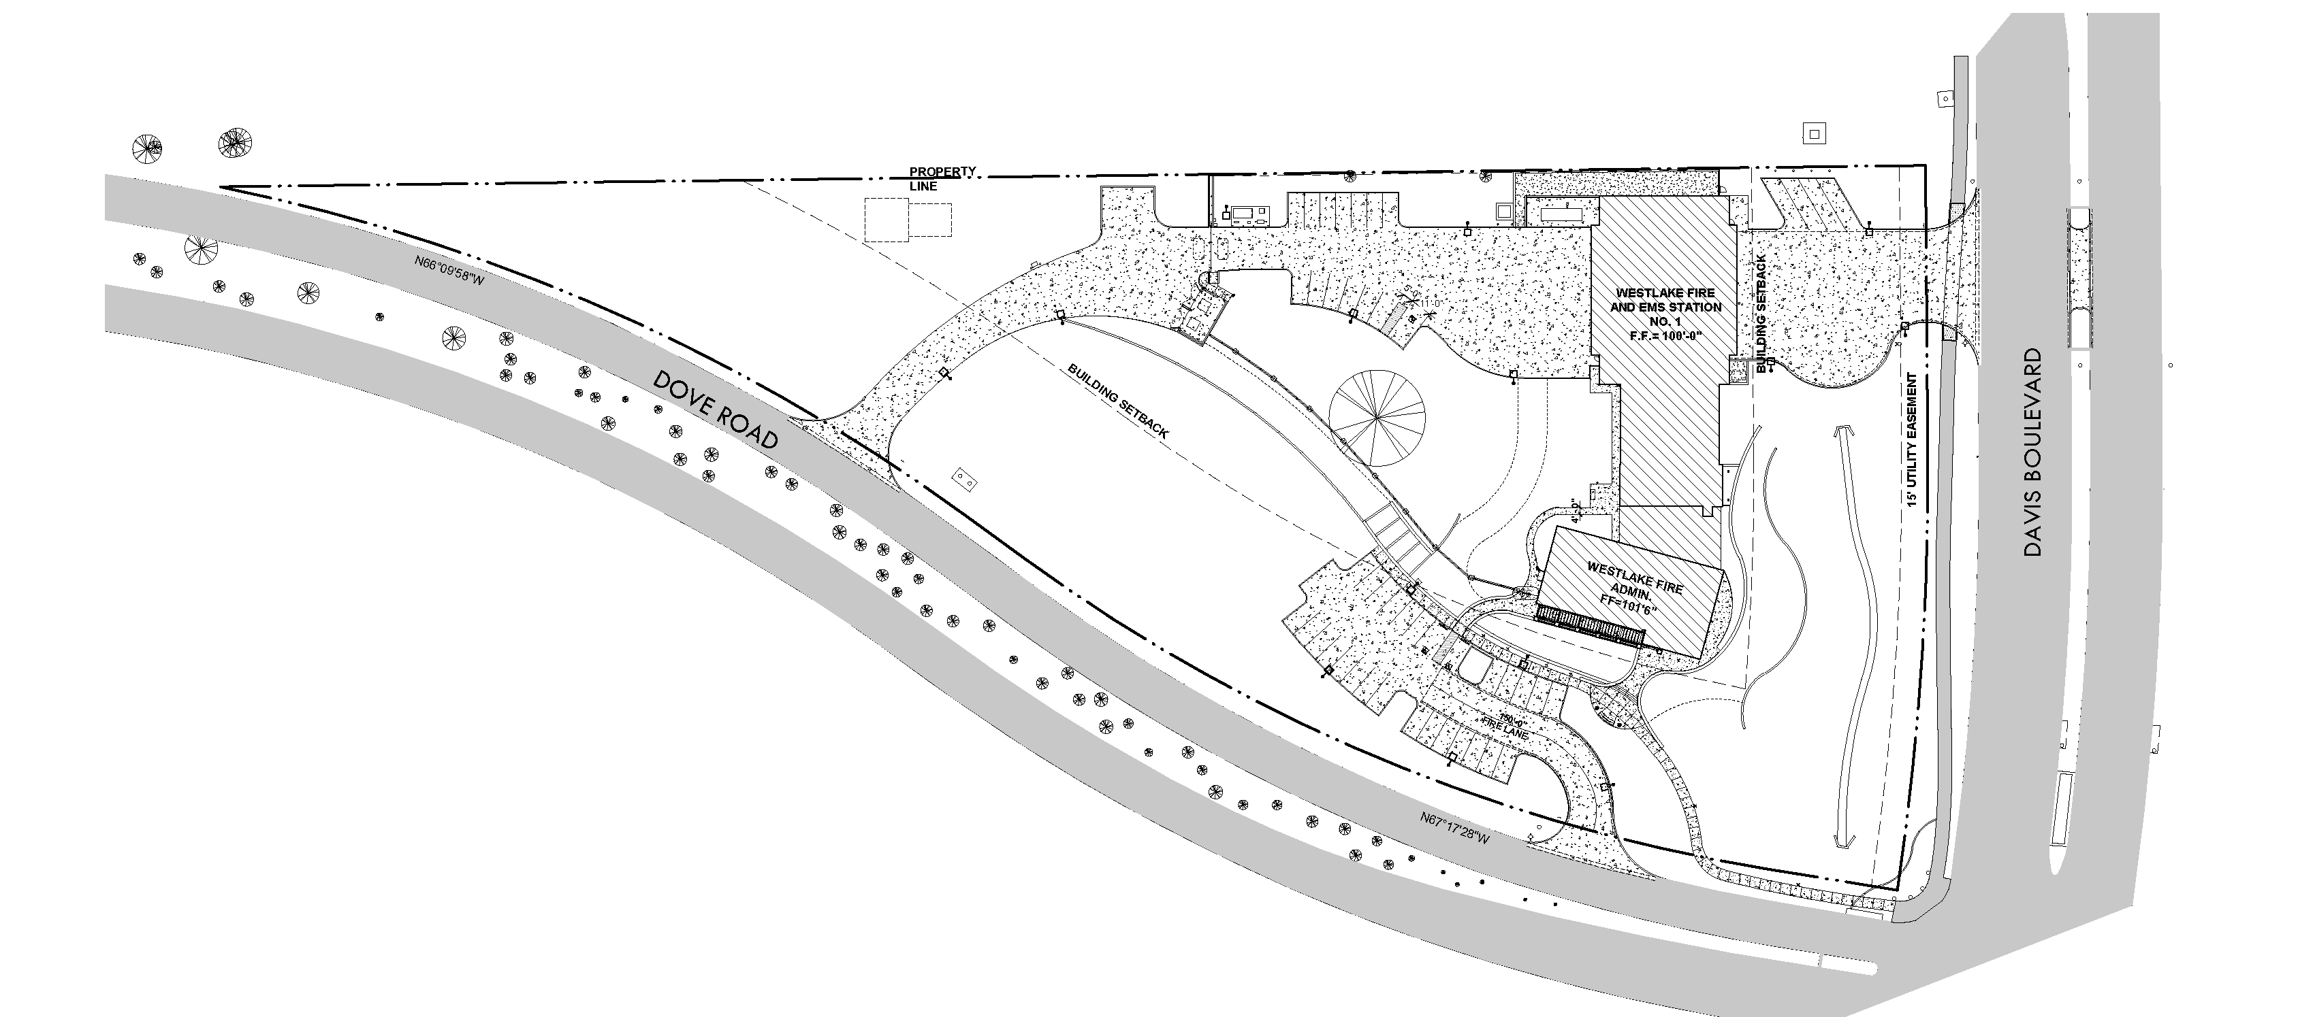
Proposed Site Location

Slide 4
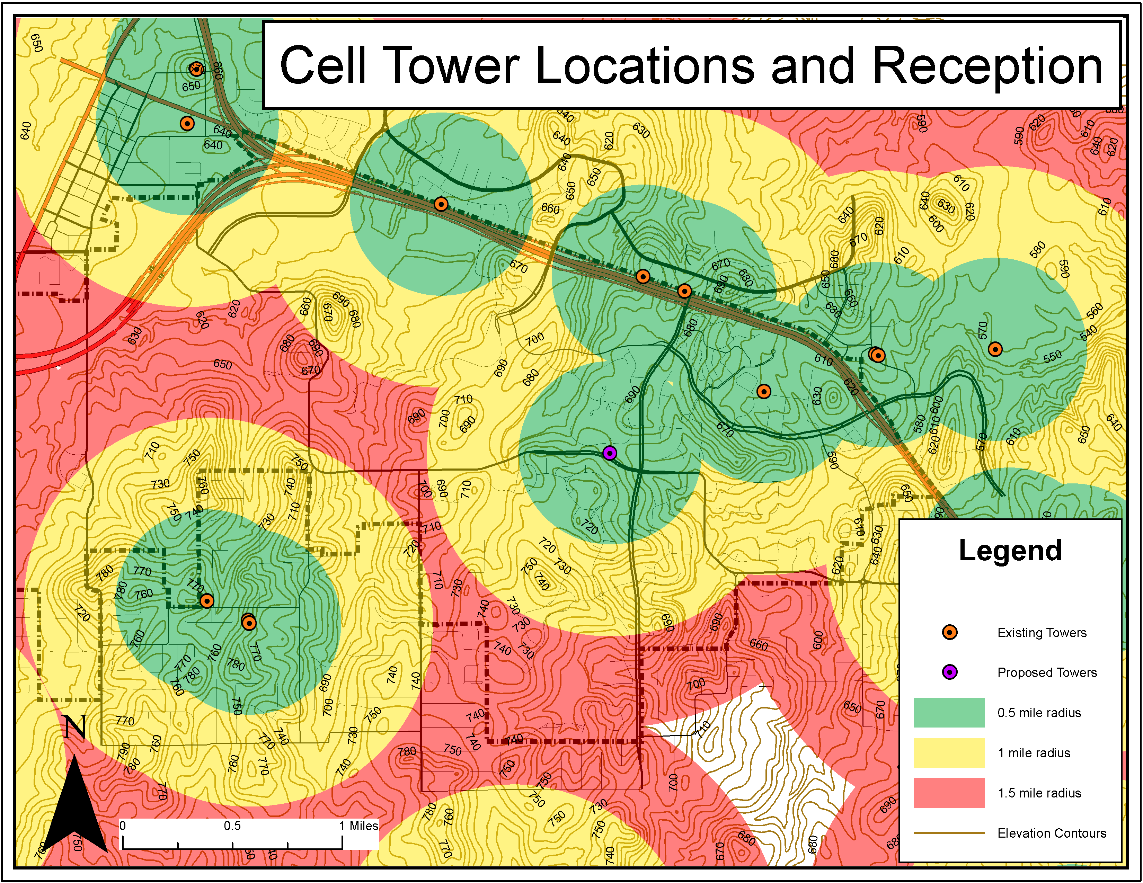

Slide 5
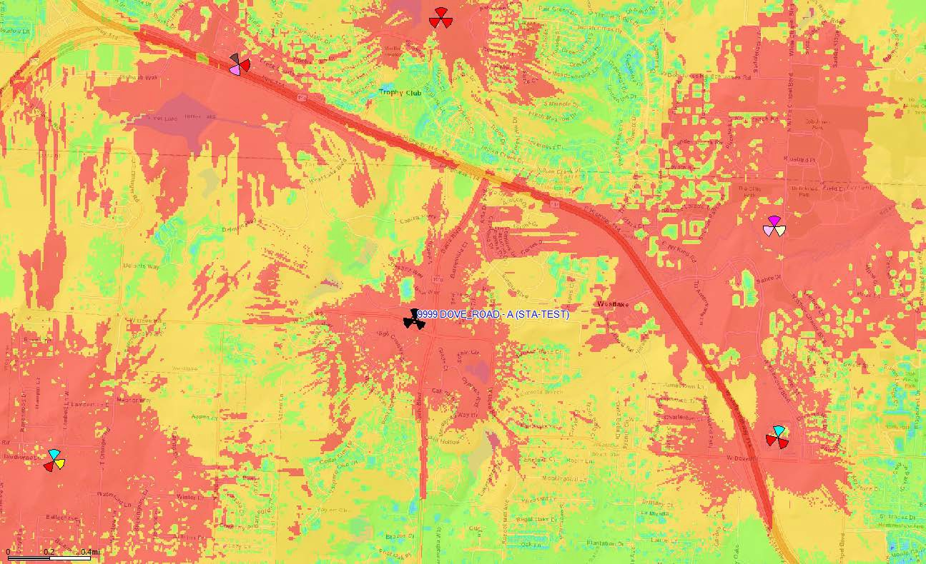
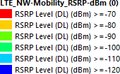
700 -
DOVE_ROAD (100’ feet)

Slide 6
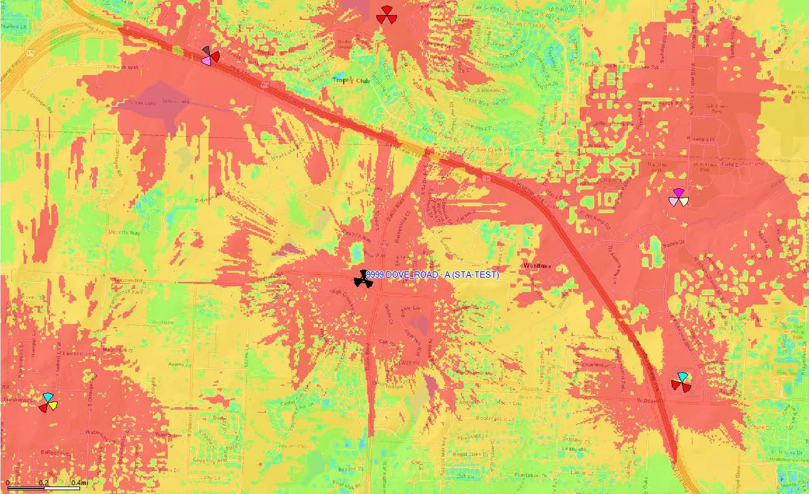
700 -
DOVE_ROAD (120’ feet)

Slide 7
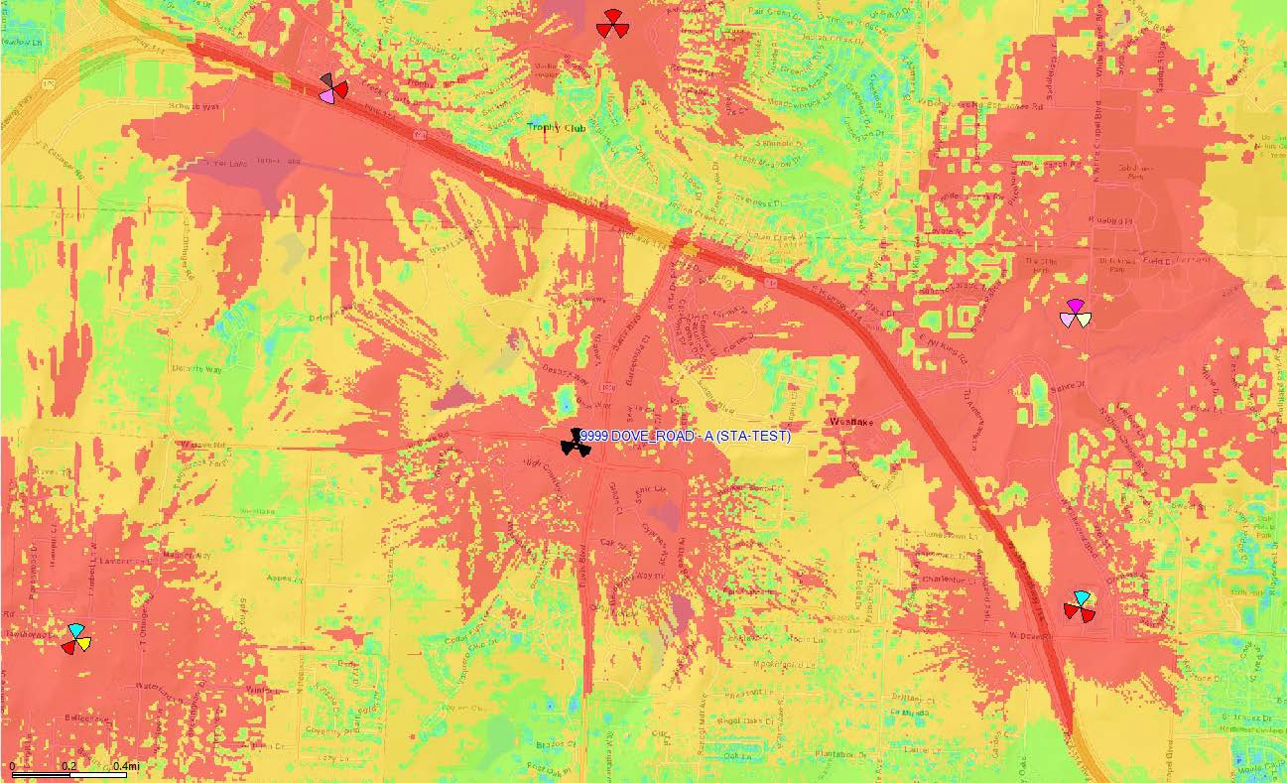
700 -
DOVE_ROAD (140’ feet)

Slide 8
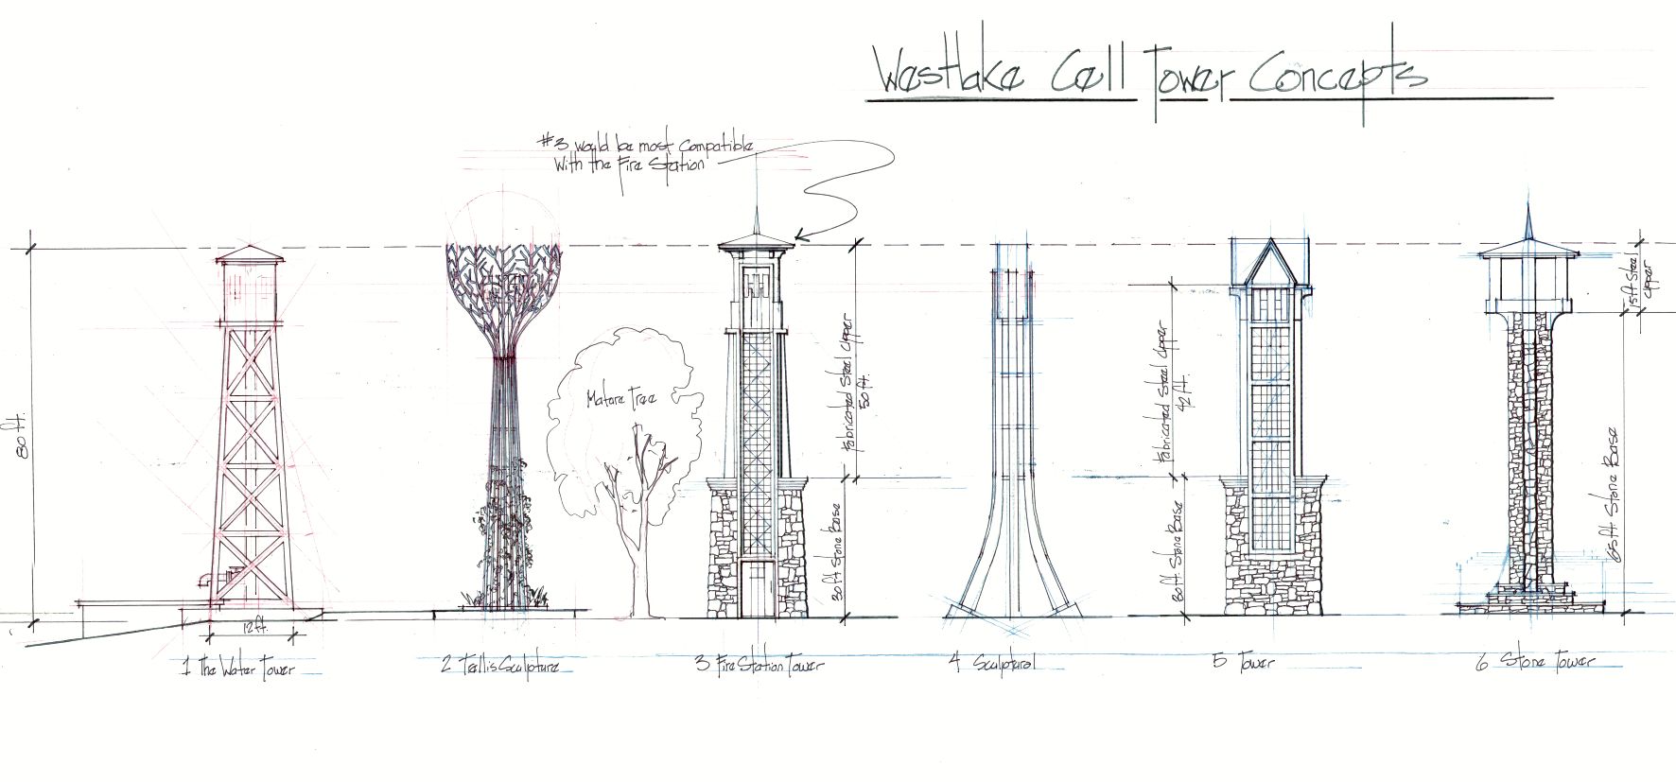
Conceptual Designs

Slide 9
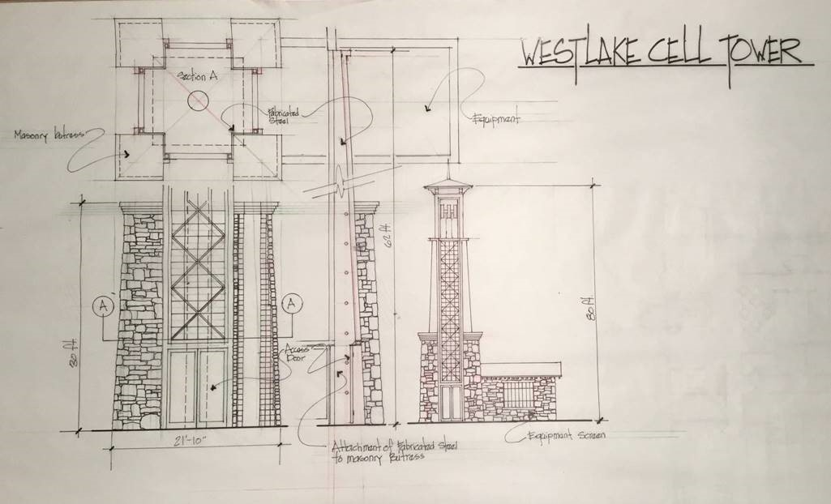

Slide 10
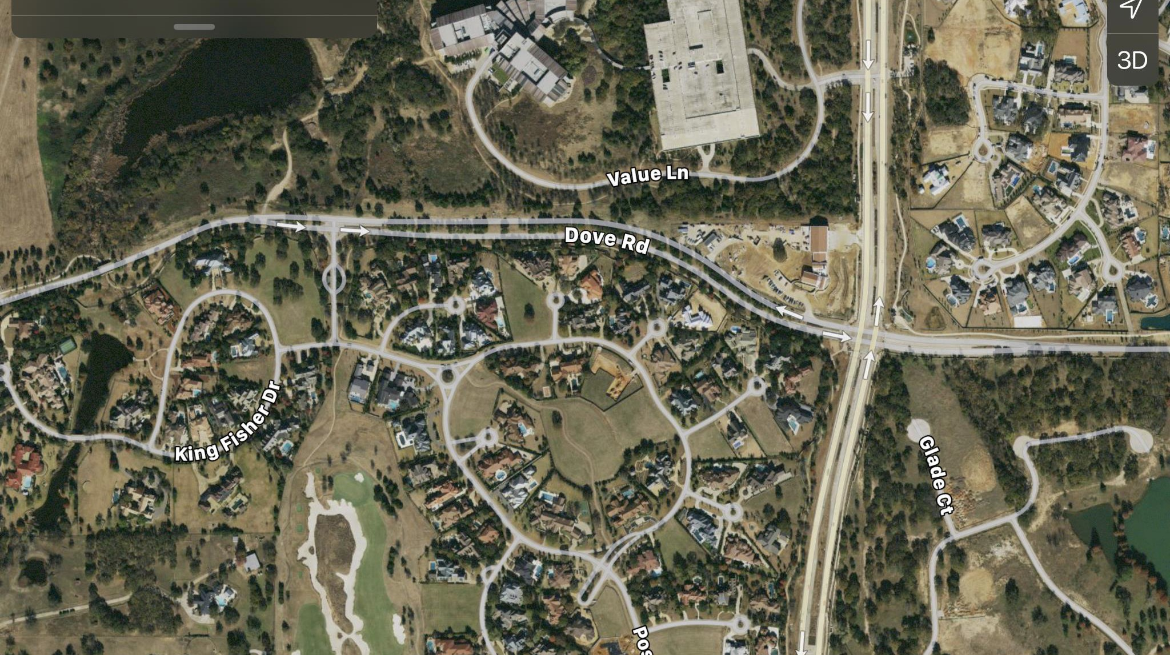









Location Map
VIEW 4
BALLOON
DAVIS BLVD.
Town of Westlake Fire-EMS Department 2000 Dove Rd., Westlake TX

Slide 11
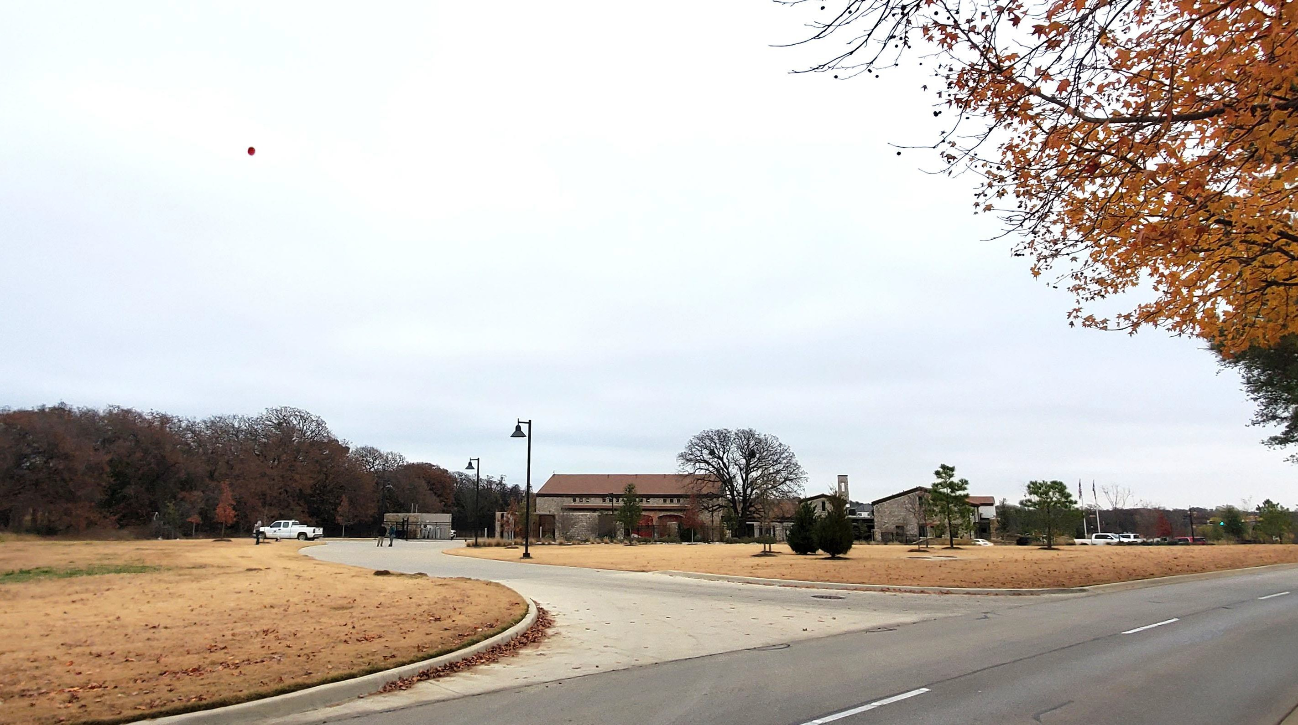

Slide 12
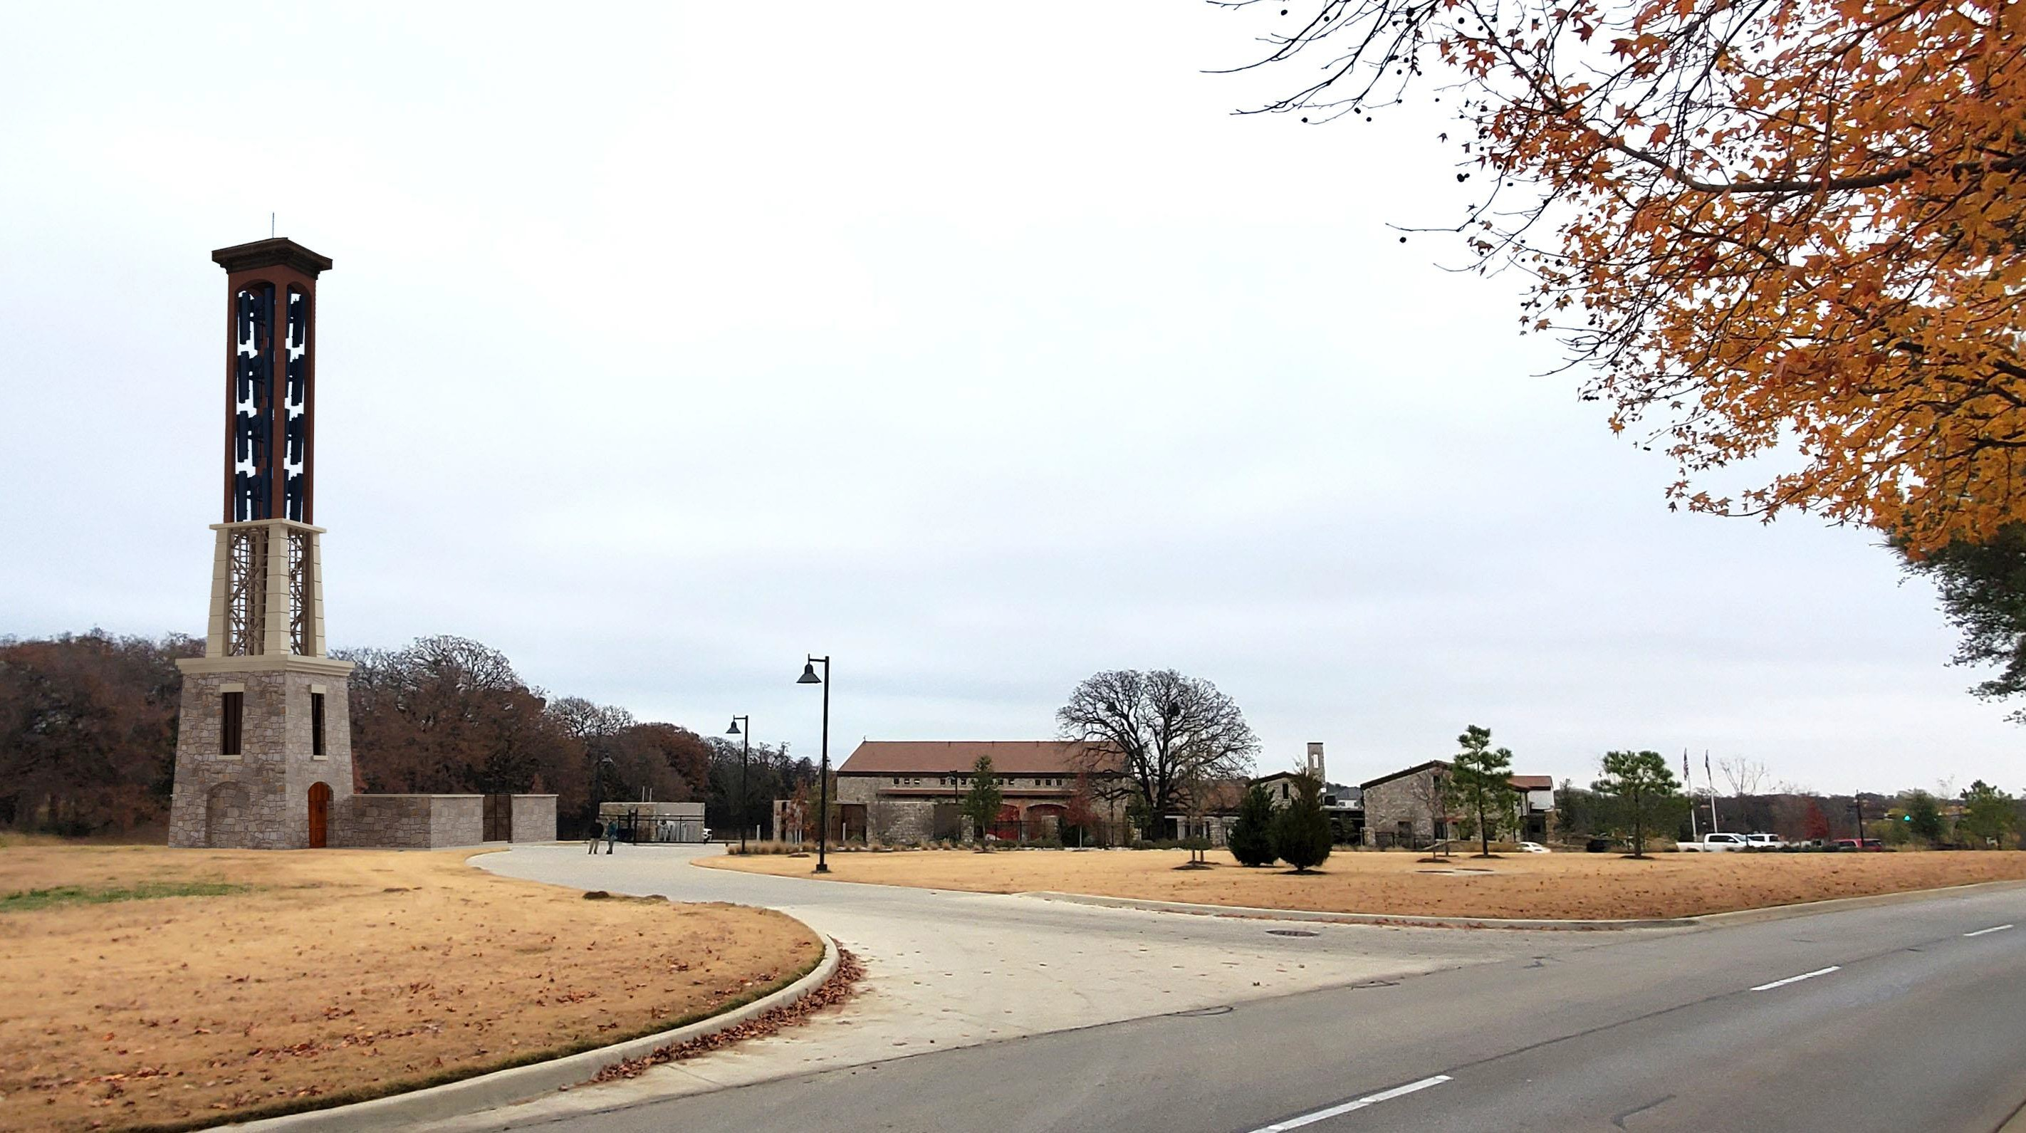
Fire Station Site
100 ft Tower

Slide 13
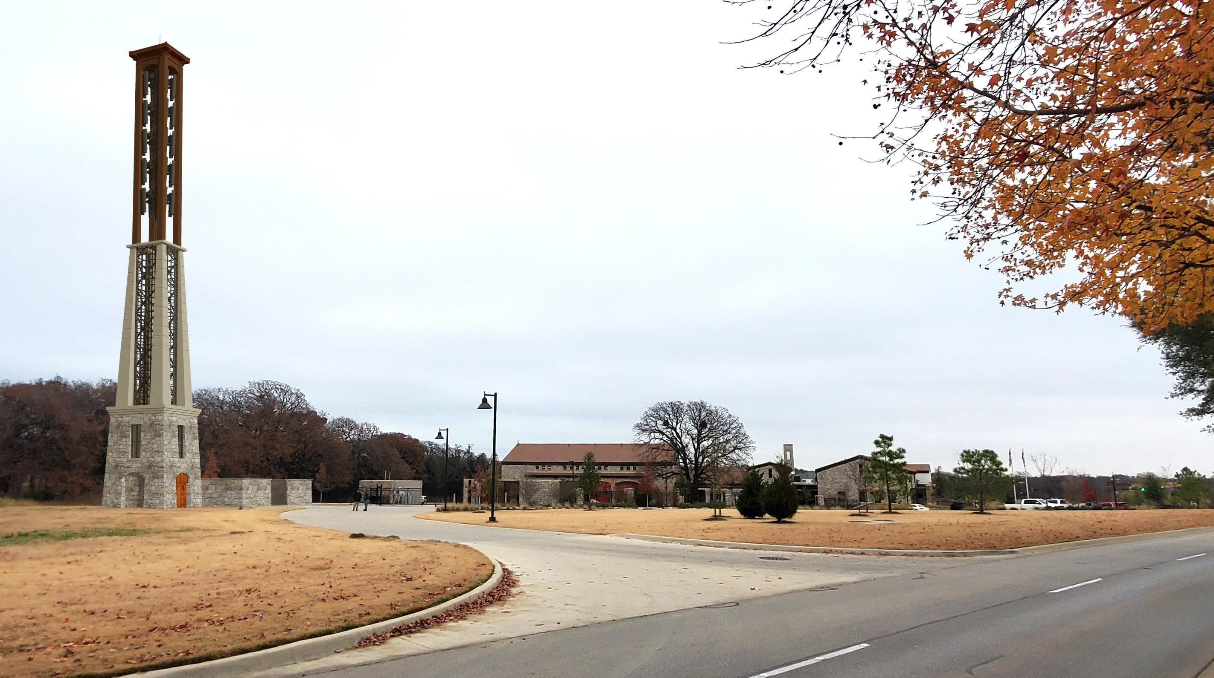
PROPOSED 150’ HIGH TOWER
WITH VERIZON WIRELESS ANTENNAS

Slide 14
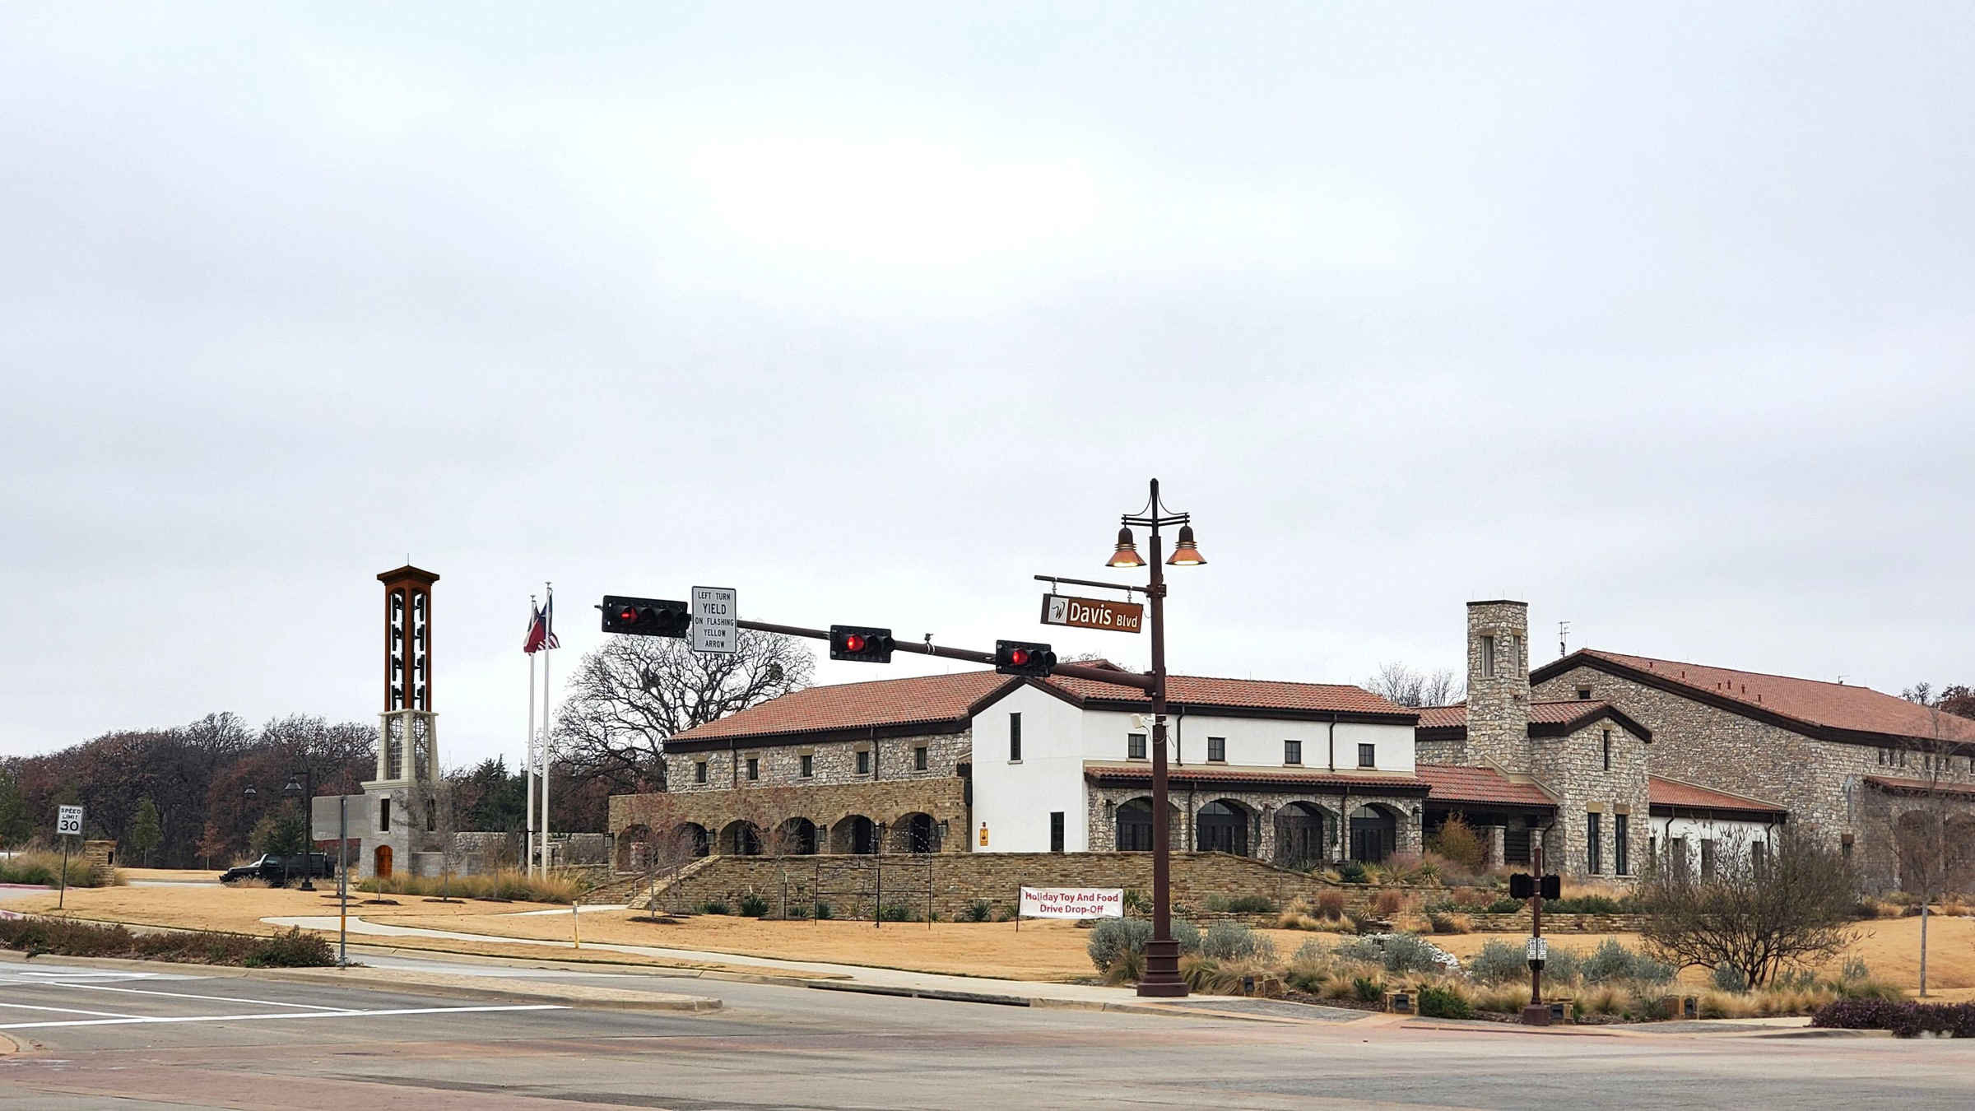
Davis/Dove Rd Intersection
100 ft Tower

Slide 15
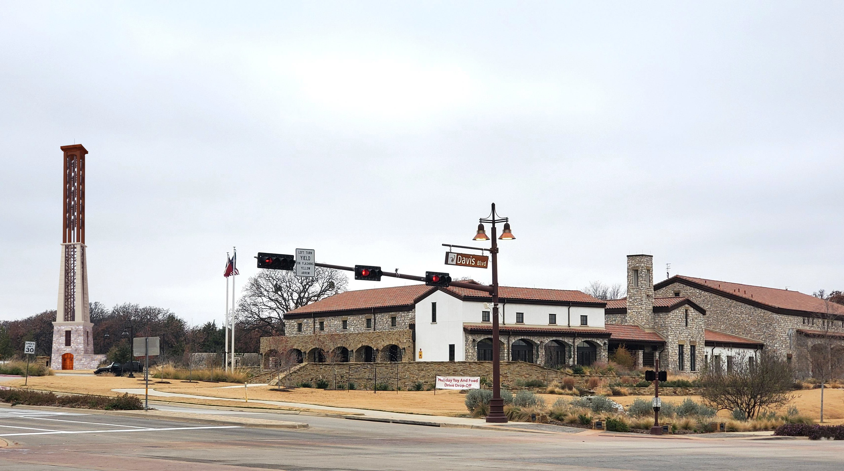
PROPOSED 150’ HIGH TOWER WITH VERIZON WIRELESS ANTENNAS

Slide 16
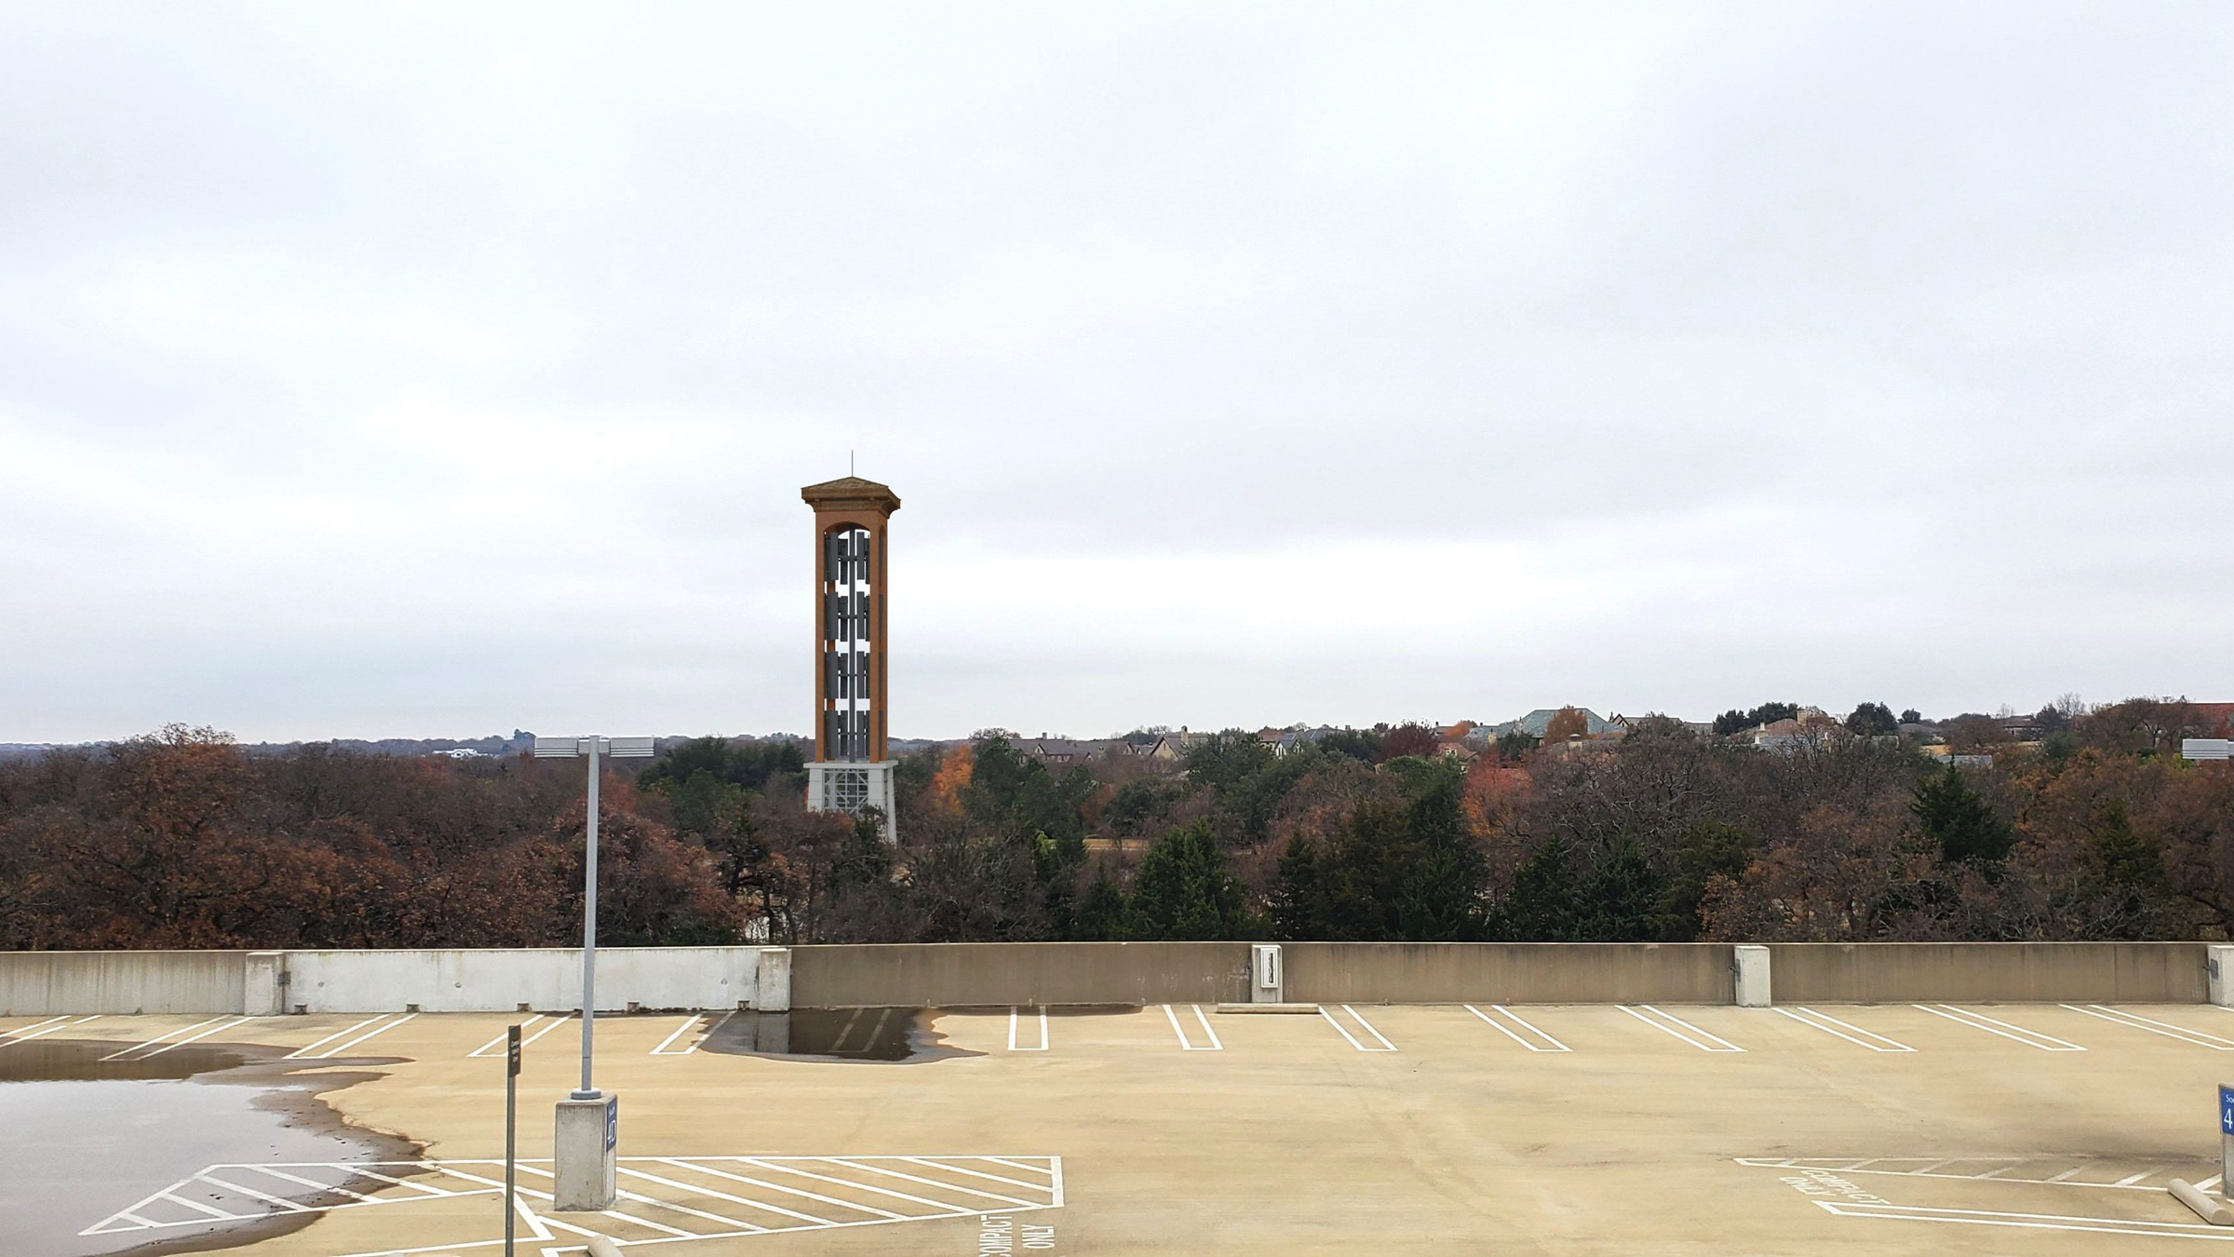
Fidelity Parking Garage

Slide 17
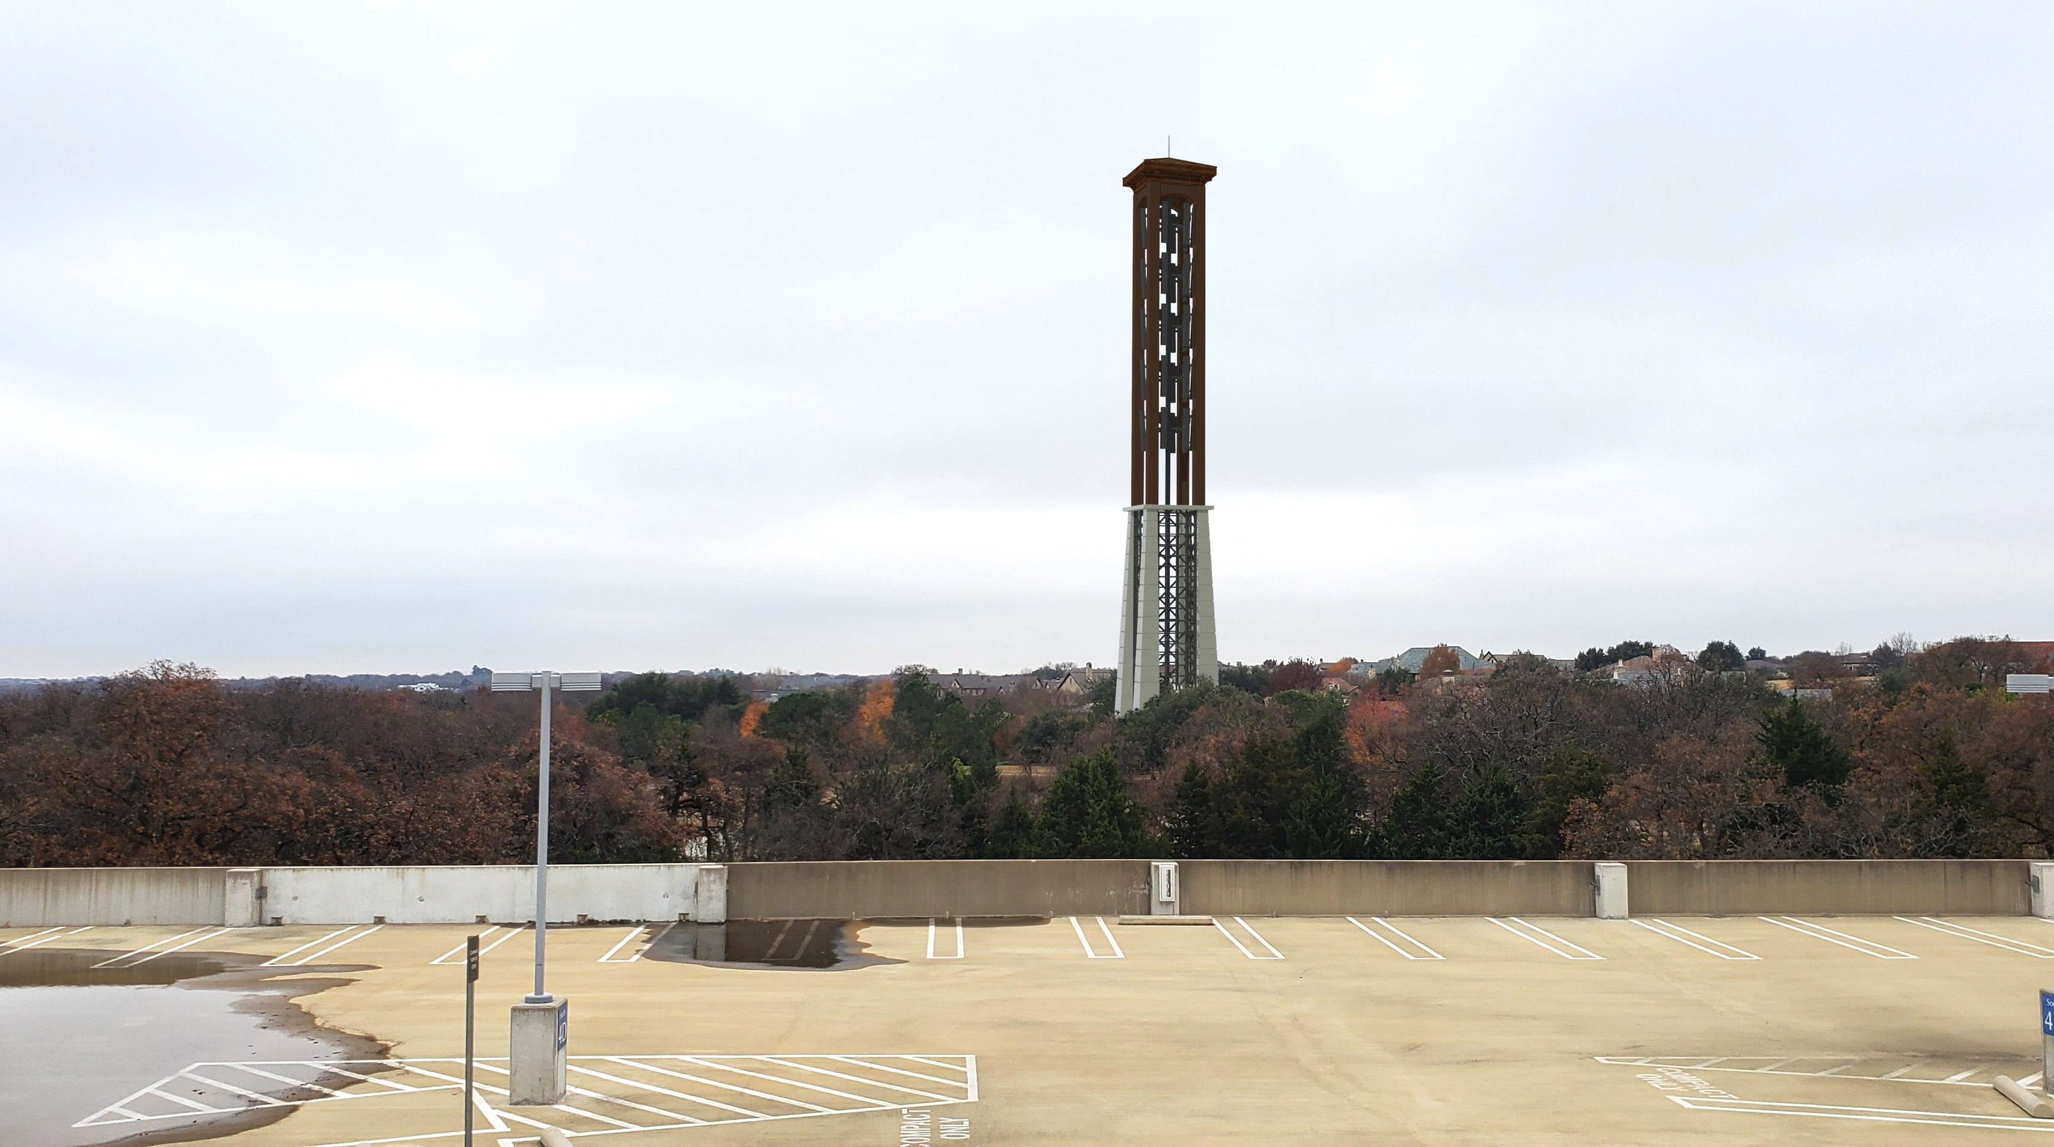
PROPOSED 150’ HIGH TOWER WITH VERIZON WIRELESS ANTENNAS

Slide 18
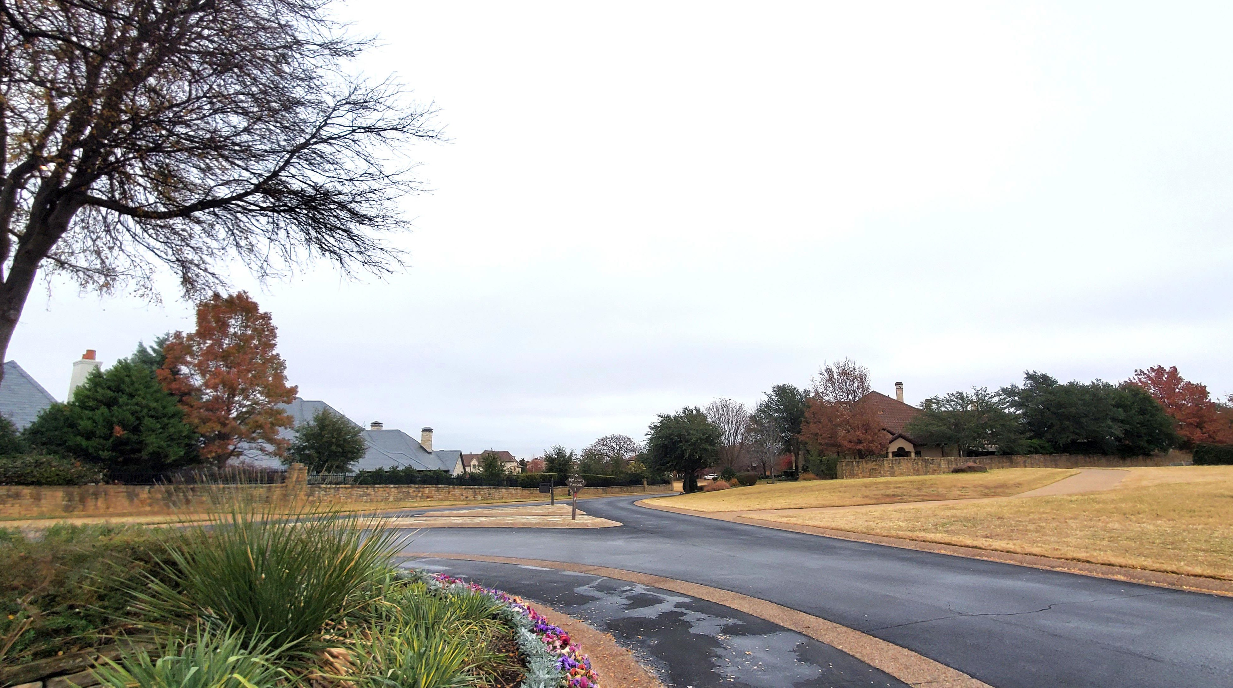
Post Oak/Davis Blvd. Roundabout

Slide 19
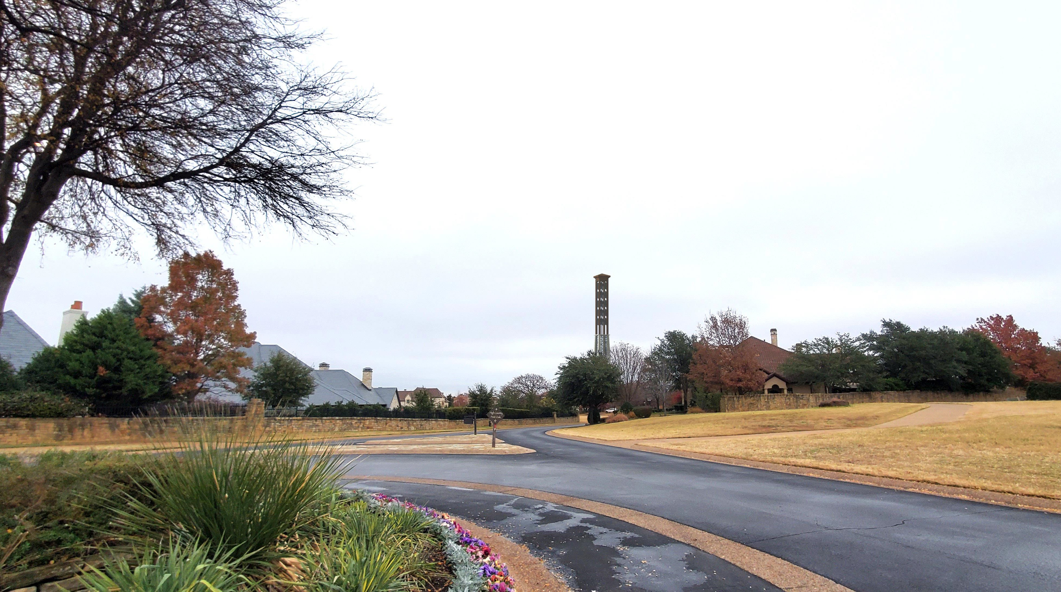
Post Oak/Davis Blvd. Roundabout

Slide 20
Questions?

Slide 21
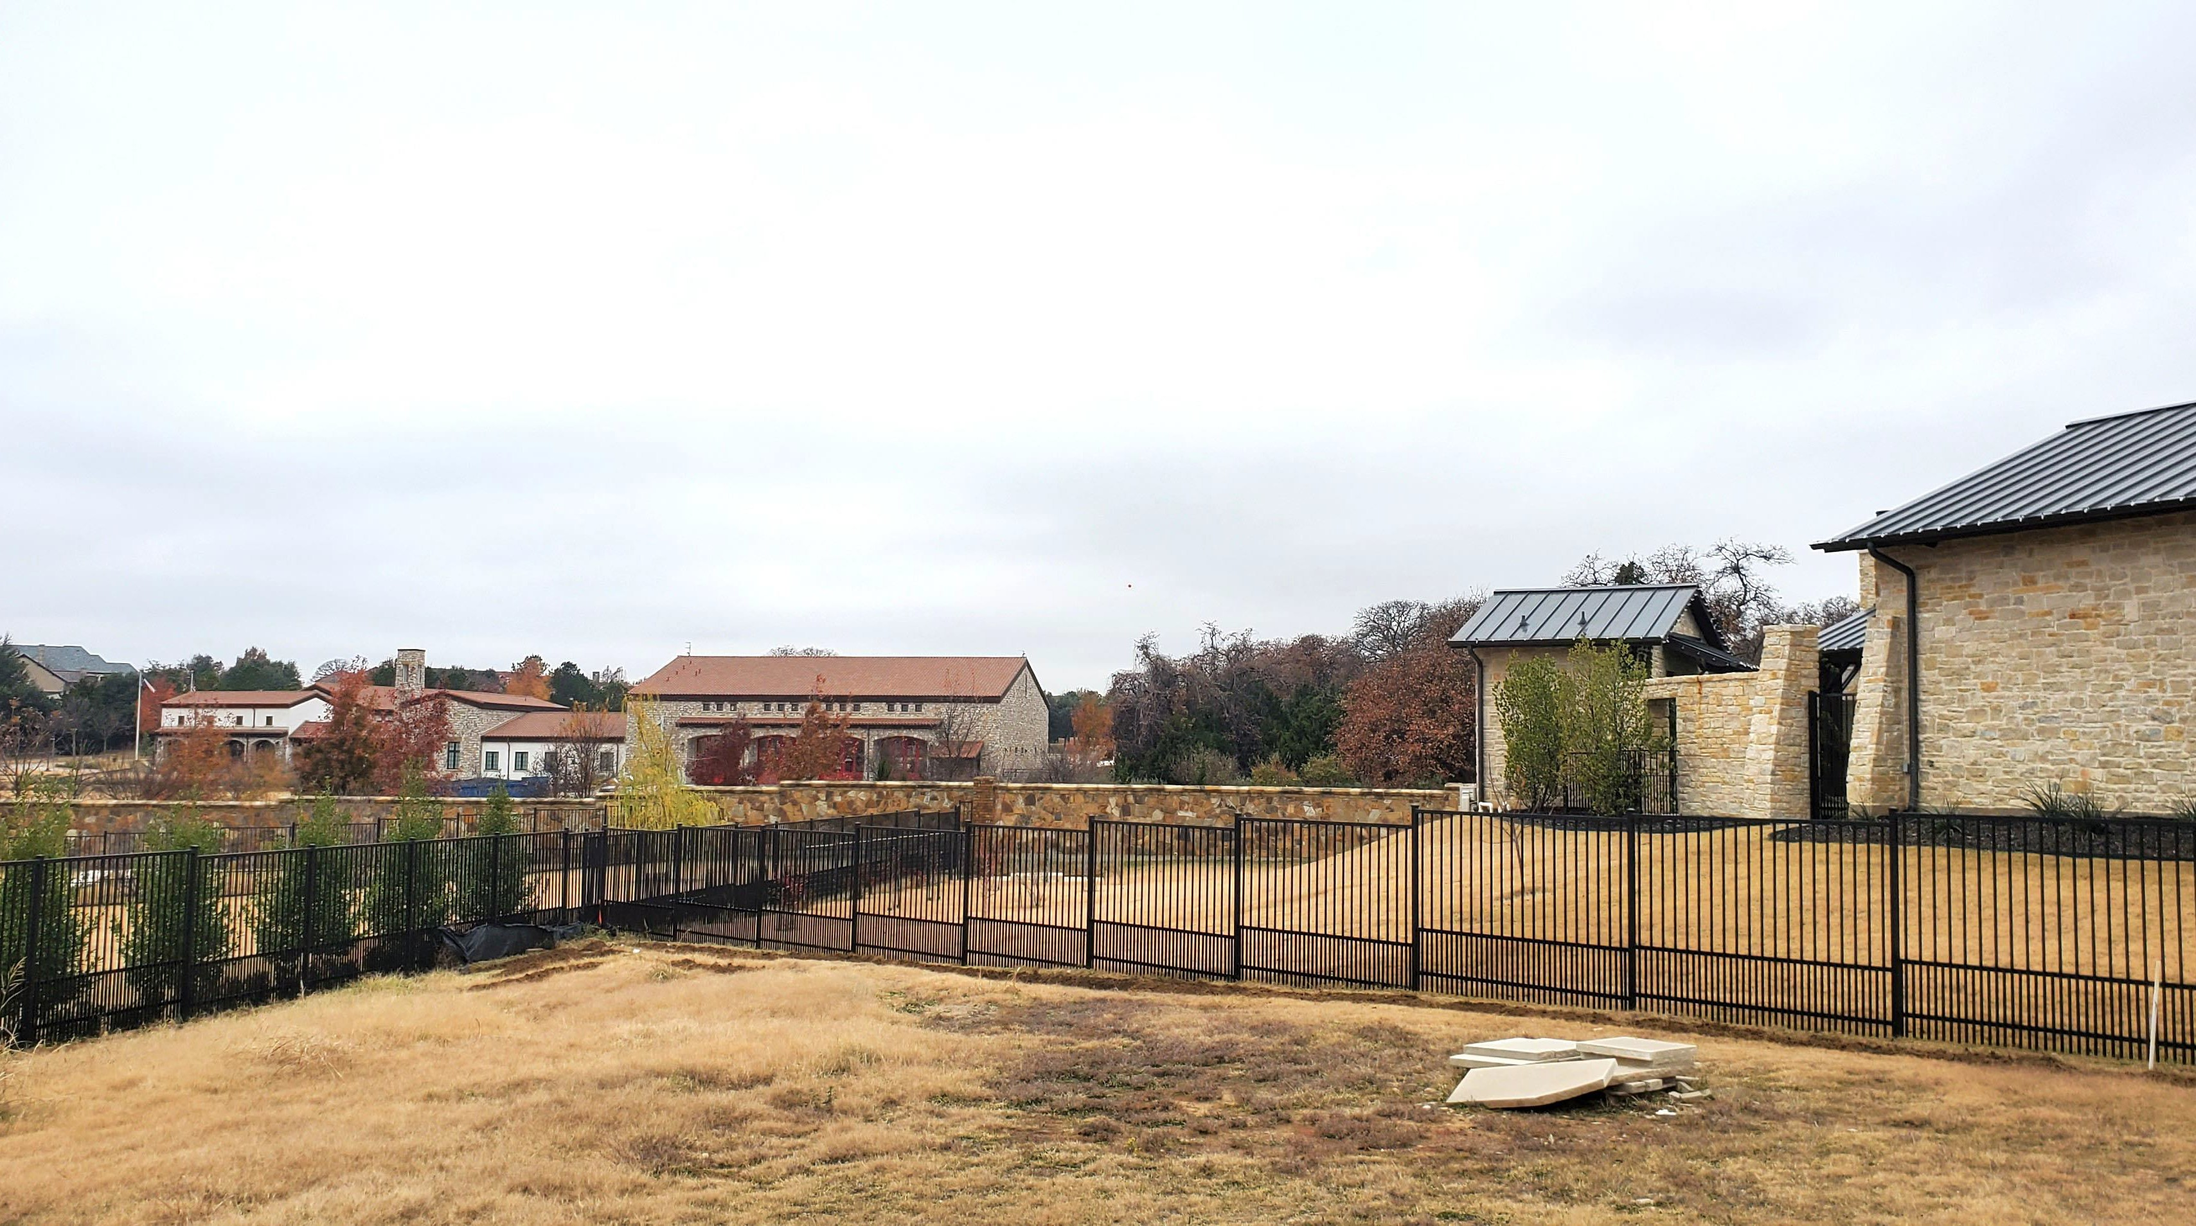

Slide 22


Slide 23
