Slide 1


TOWN OF WESTLAKE
COMMUNICATIONS TOWER

Slide 2
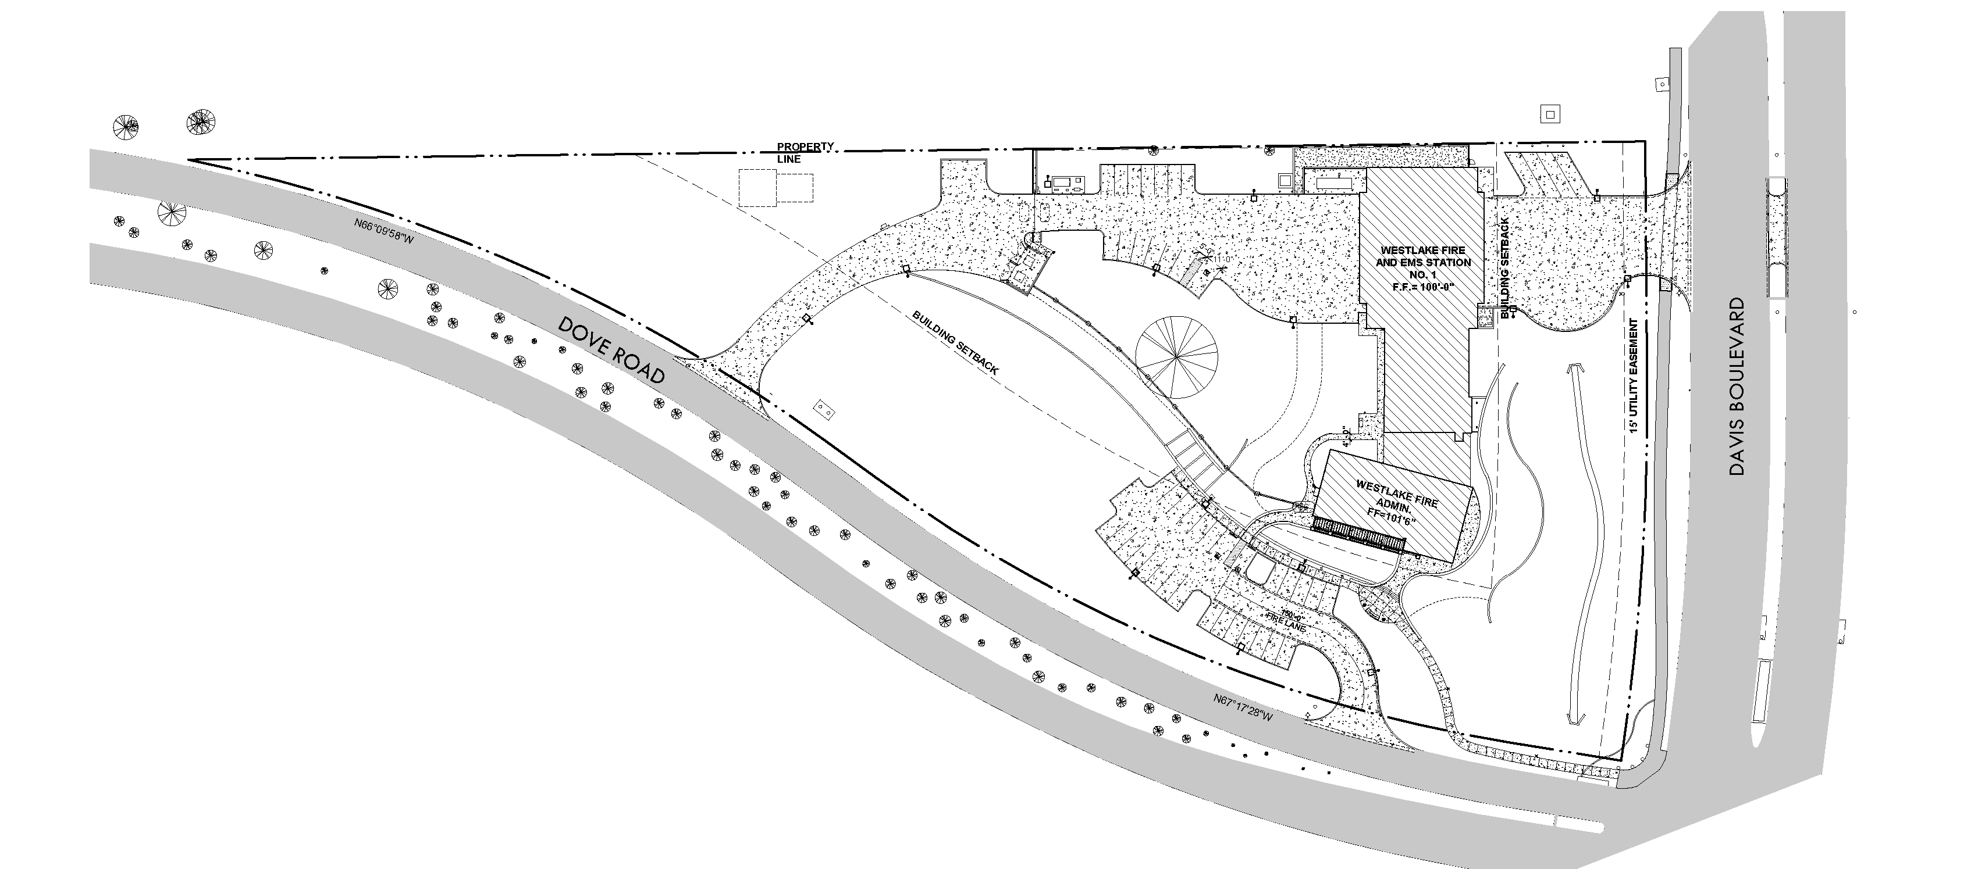
Proposed Site Location

Slide 3
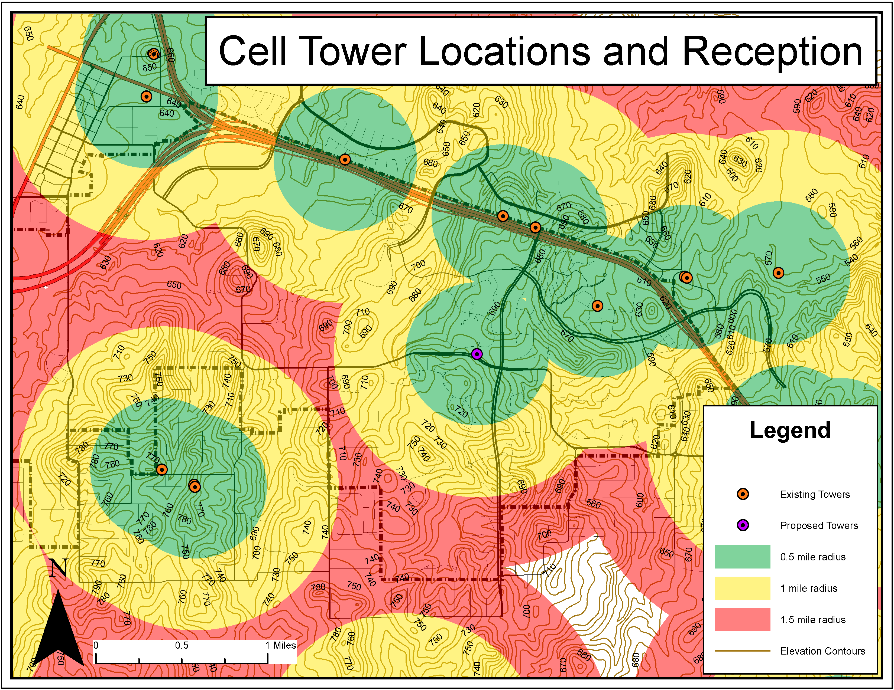

Slide 4
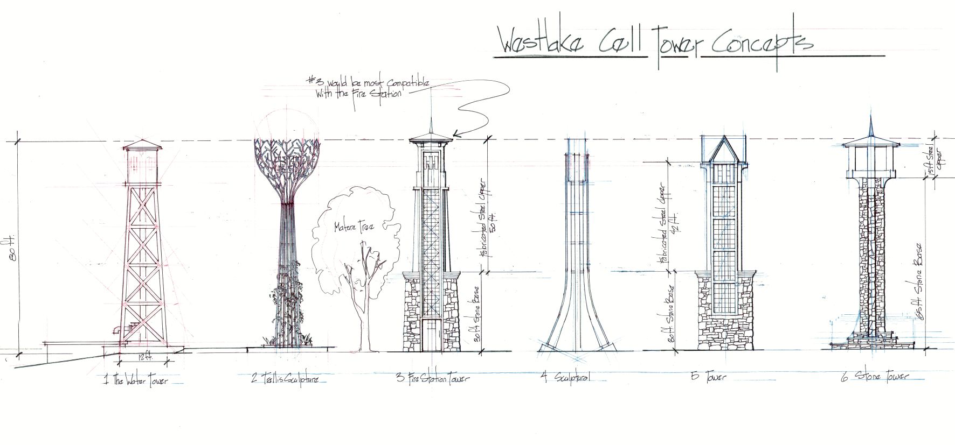
Conceptual Designs

Slide 5
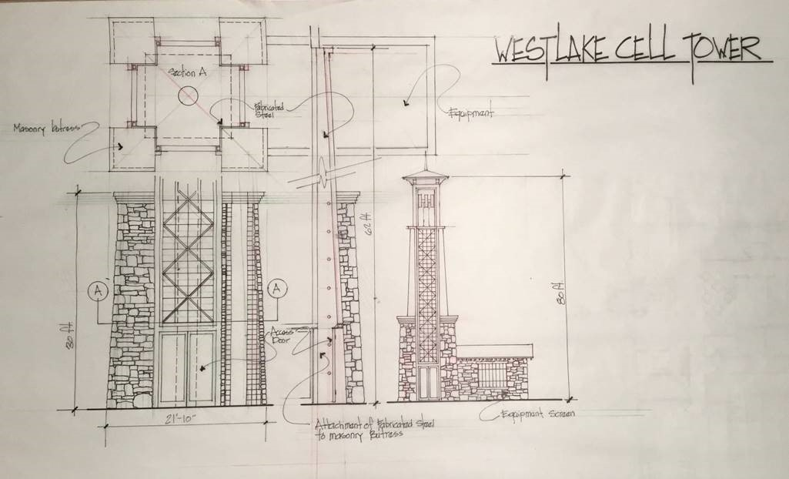

Slide 6
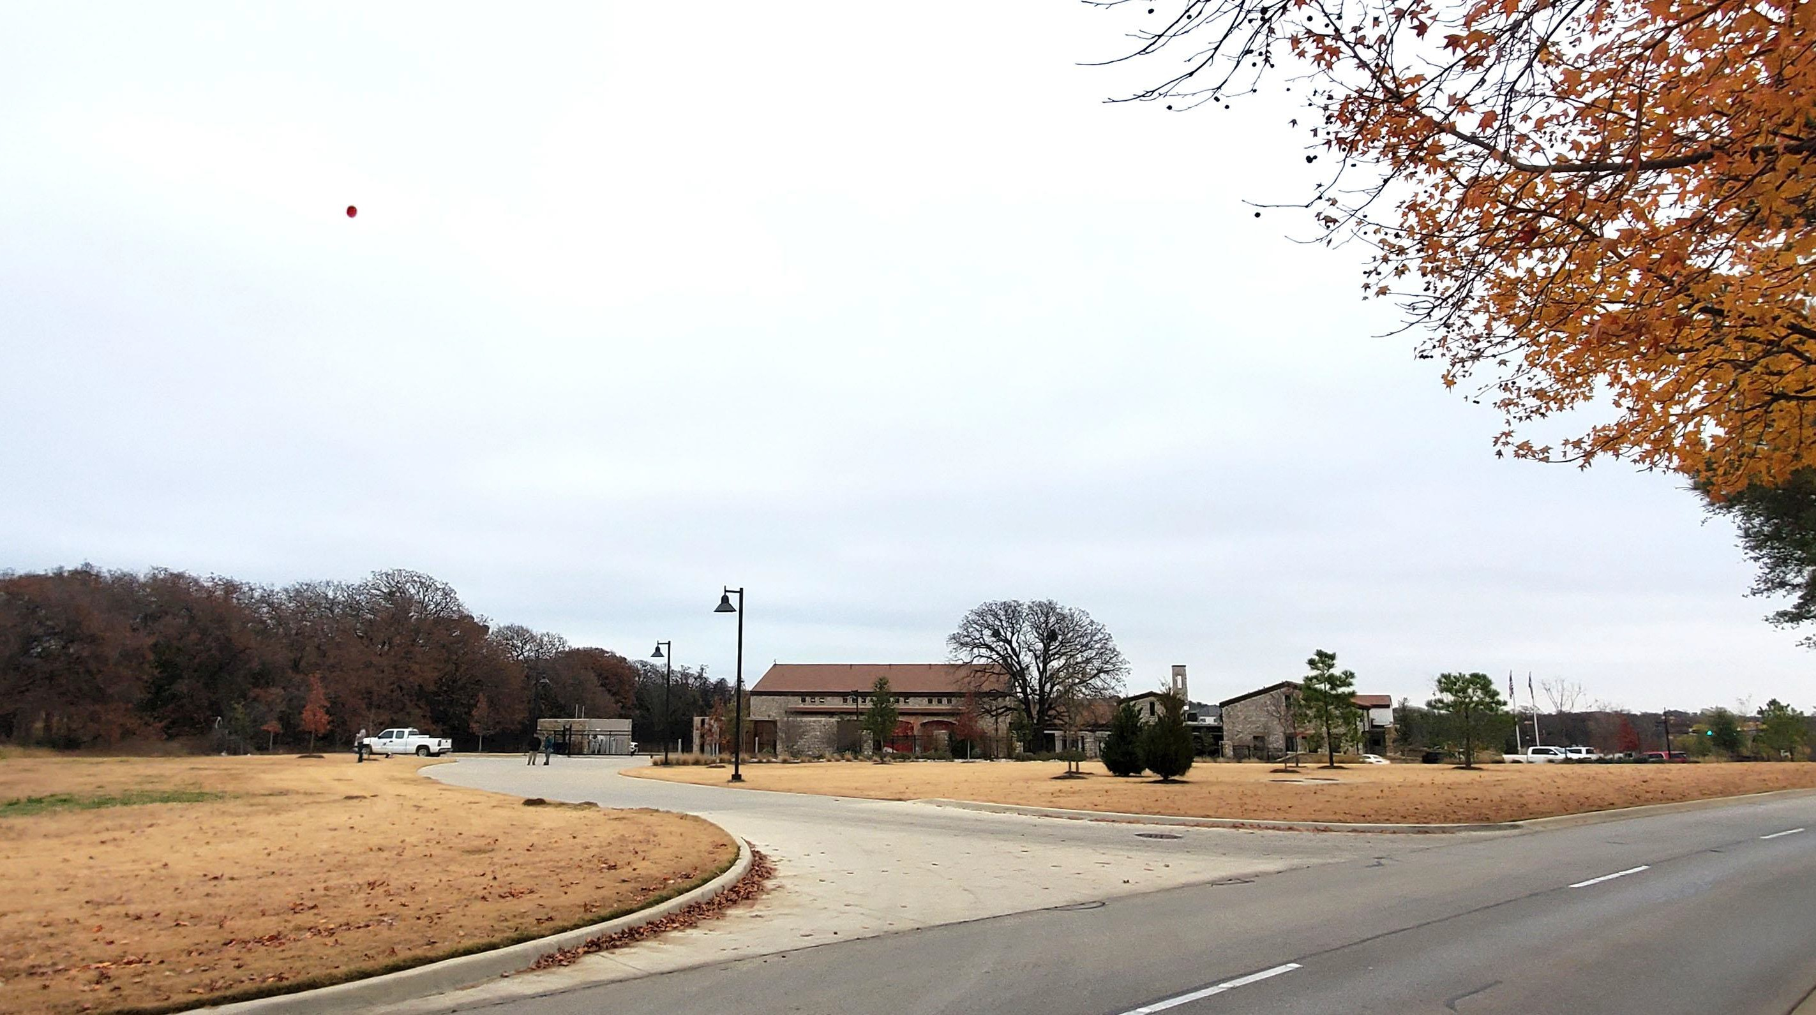

Slide 7
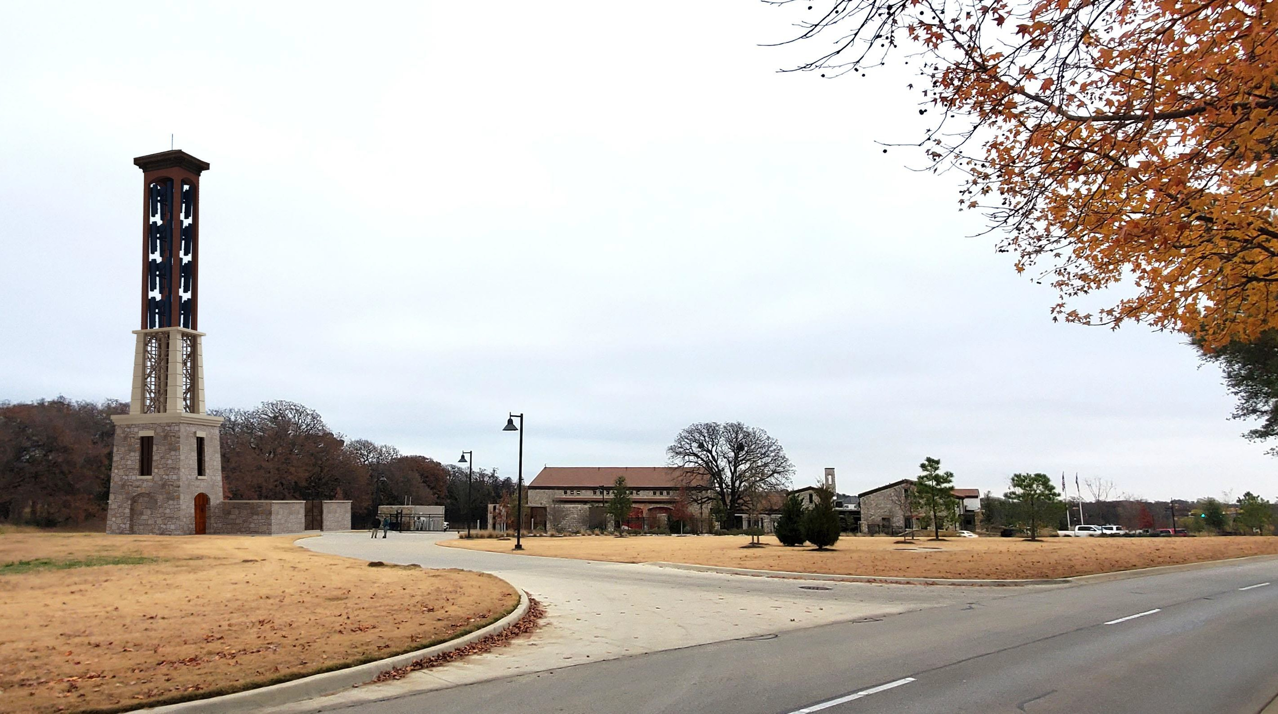

Slide 8
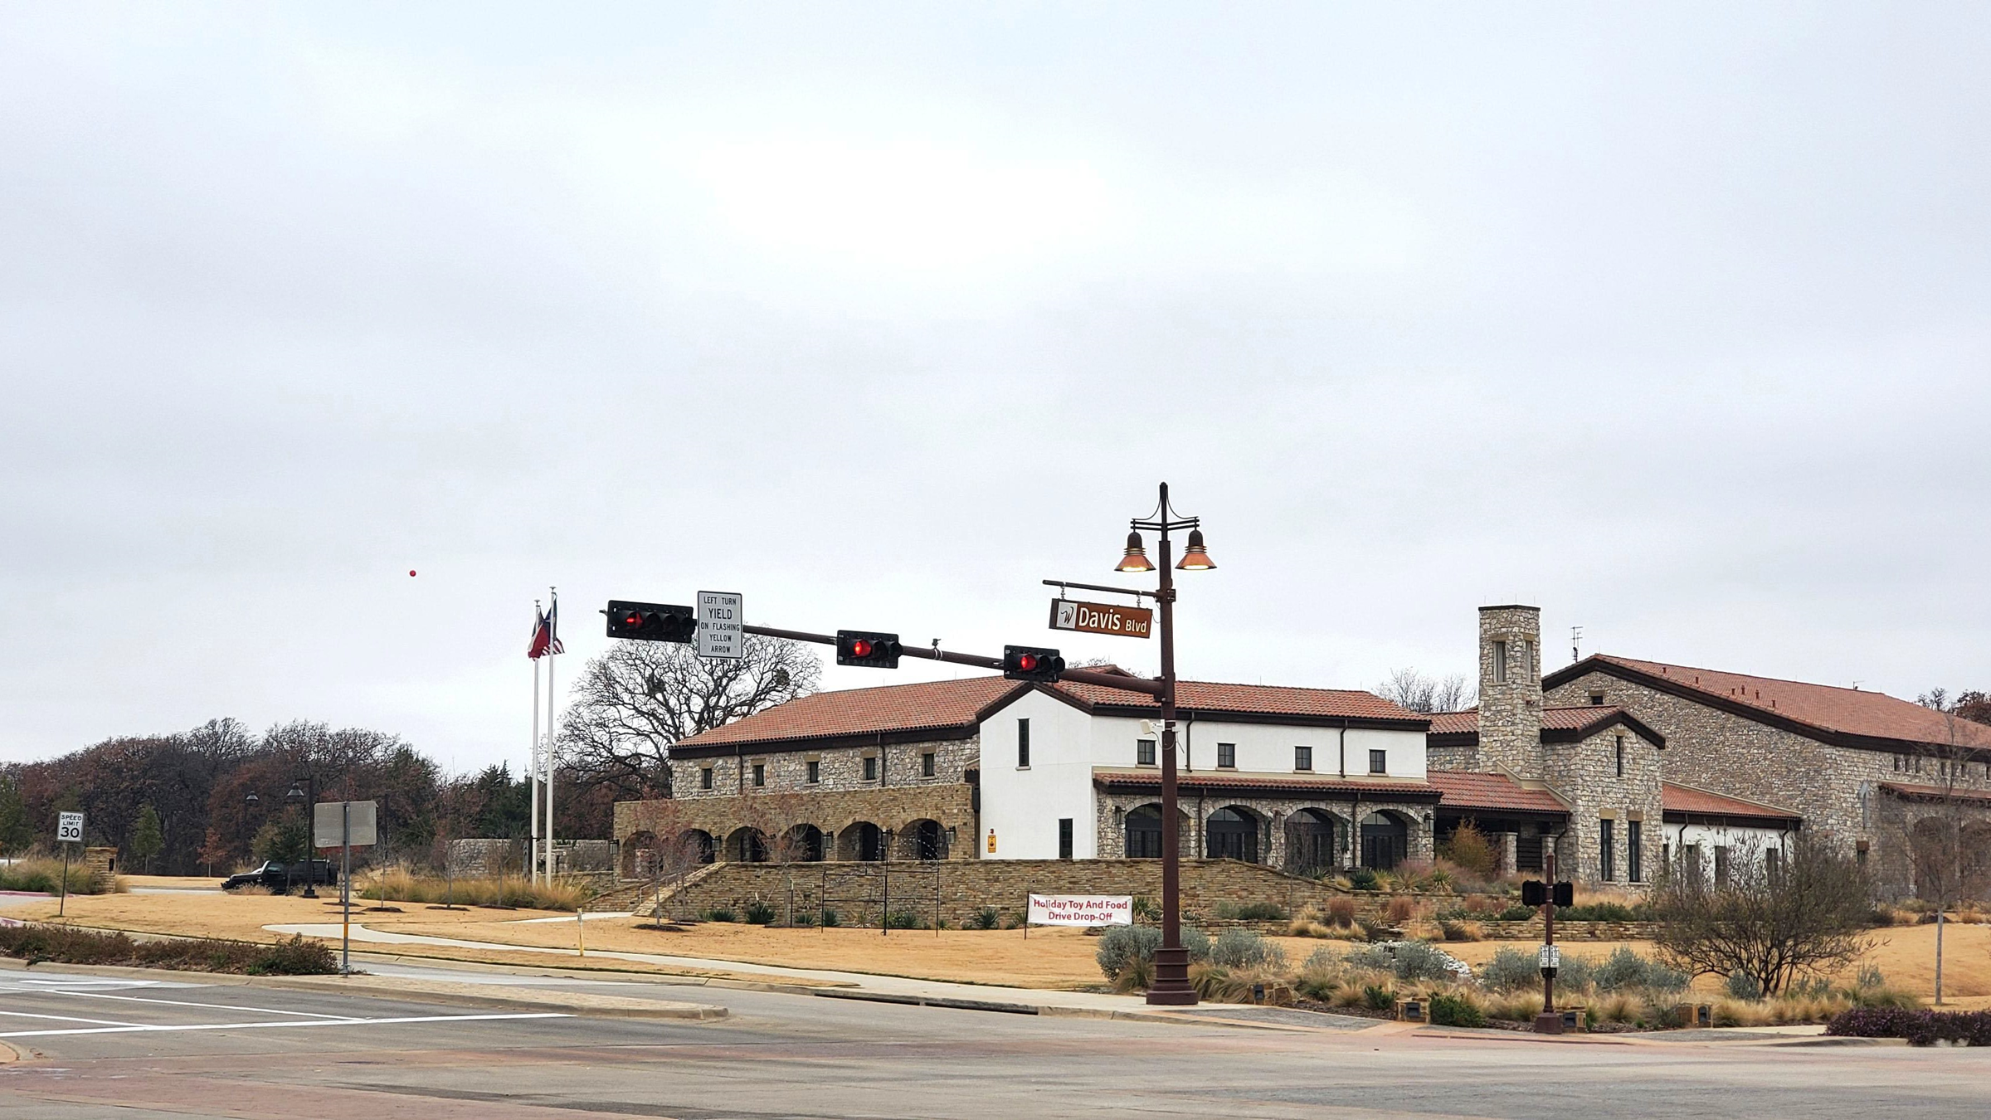

Slide 9
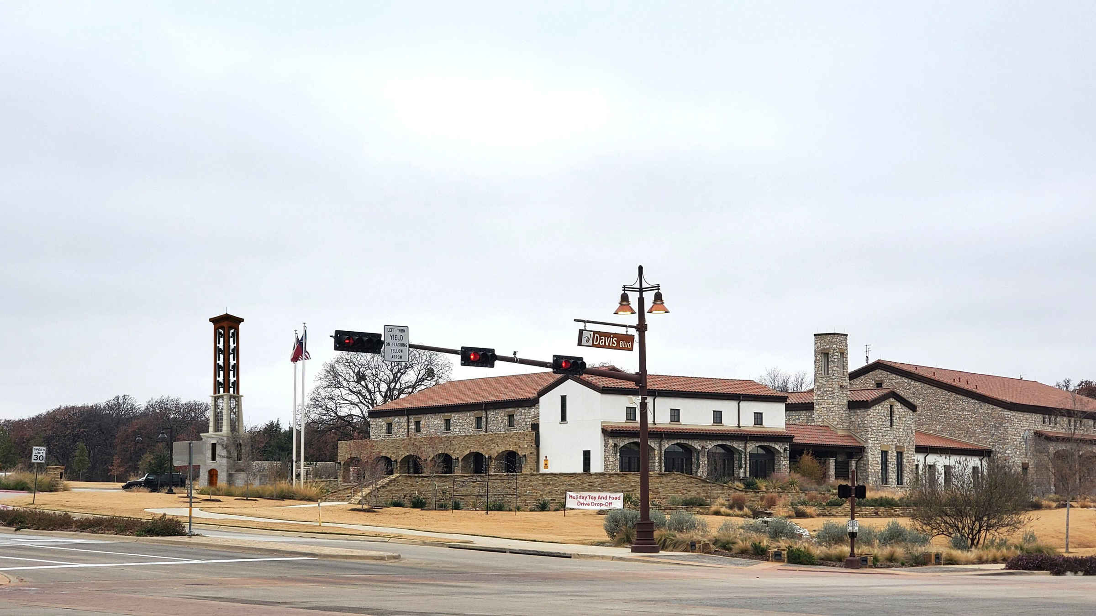

Slide 10
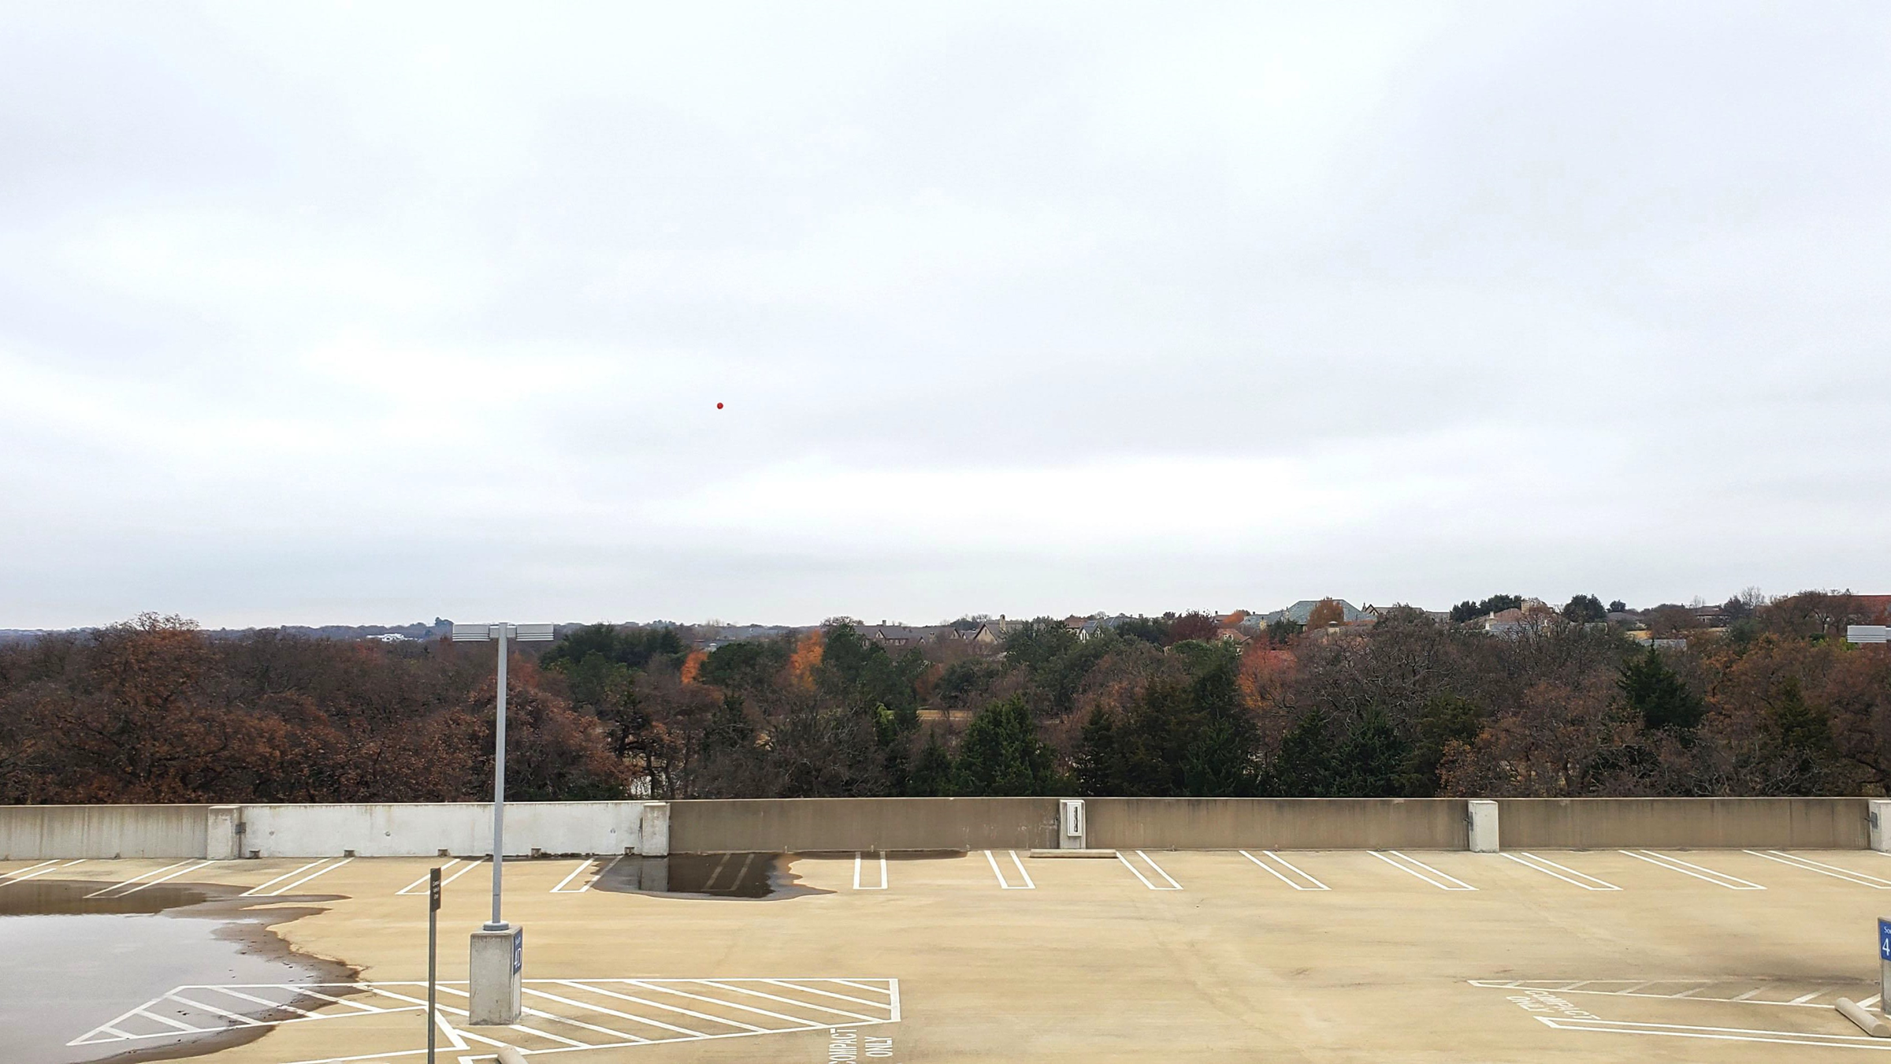
View from Fidelity Parking Garage toward Dove Road

Slide 11
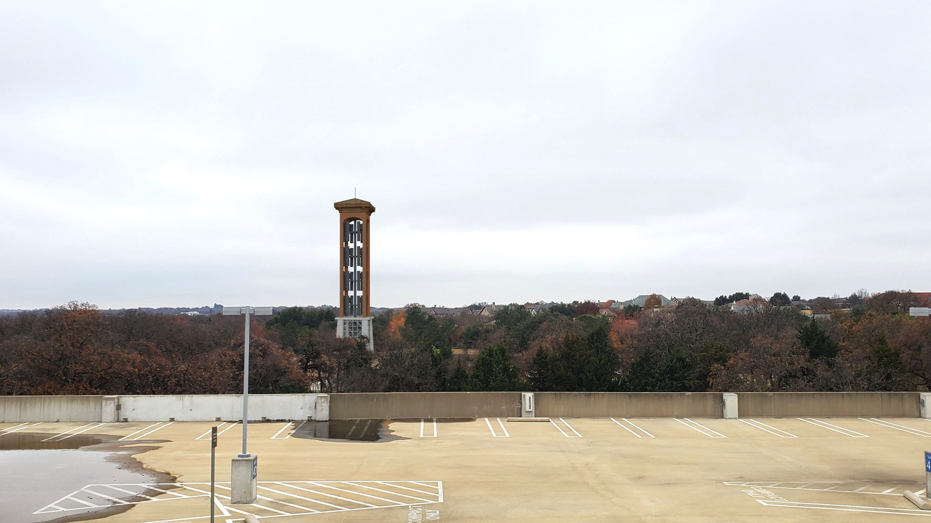
View from Fidelity Parking Garage toward Dove Road

Slide 12
Questions?

Slide 13
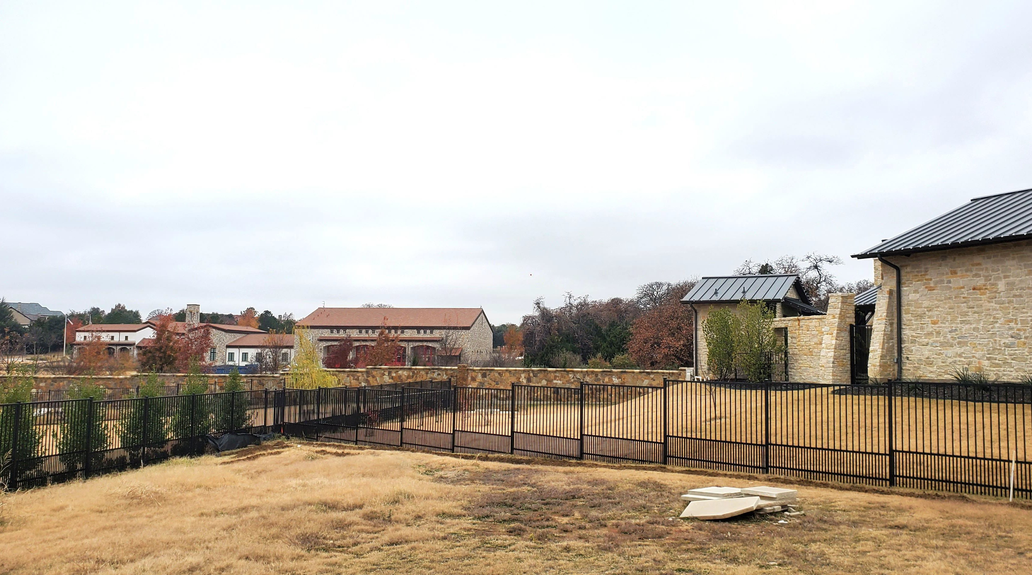

Slide 14


Slide 15
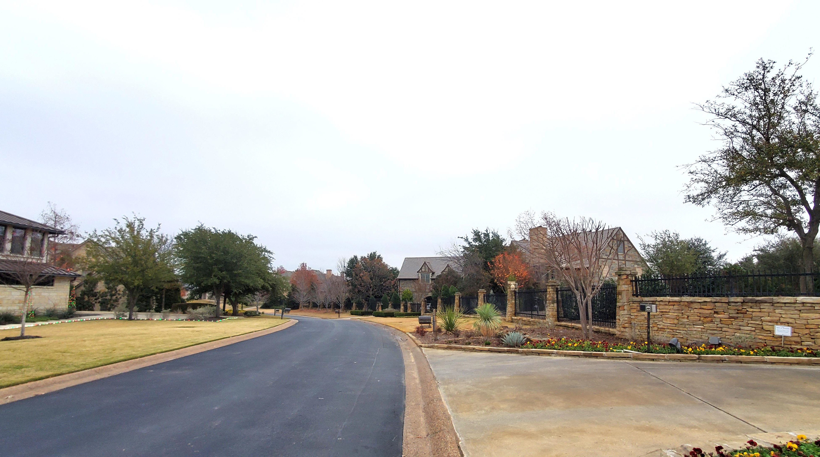

Slide 16
