Slide 1
Keller Police Department Town of Westlake End of Year 2020
Chief Bradley G. Fortune
March 29, 2021
Excellence • Integrity • Service • Creativity • Communication

Slide 2
Department Mission & Values
The Keller Police Department is a value driven organization committed to excellence and will partner with the community to make Keller a better place to live, visit and conduct business.
E⁴ Core Value System
Empathy
Edification
Enthusiasm
Excellence

Slide 3
Policing Philosophy
Procedural Justice: the idea of fairness in the processes that resolve disputes and allocate resources. It is the concept that, when embraced, promotes positive organizational change and bolsters better relationships.
Procedural justice speaks to four principles, often referred to as the four pillars:
Fairness in the Processes – Dignity and Respect
Transparency in Actions – Trustworthy Motives
Opportunities for Voice
Impartiality in Decision Making – Absence of Bias
COPS (Community Oriented Policing Services), Department of Justice

Slide 4
Policing Philosophy
“The ability of the police to perform their duties is dependent upon public approval of police existence, action, behavior and the ability of the police to secure and maintain public respect.”
“The police at all times should maintain a relationship with the public that gives reality to the historic tradition that the police are the public and the public are the police; the police are the only members of the public who are paid to give full-time attention to duties which are incumbent on every citizen in the intent of the community welfare.”
Sir Robert Peel’s Principles of Law Enforcement 1829

Slide 5
President’s Task Force on 21st Century Policing
Signed by President Barack Obama on December 18, 2014
In response to civil unrest centered around critical incidents that occurred
Created to strengthen community policing and trust among law enforcement officers and the communities they serve
Eleven task force members included academics, law enforcement officials, and civil rights activists
Final report released May 18, 2015

Slide 6
Pillar 1: Building Trust & Legitimacy
Procedural Justice & Mission and Values used as the Guiding Principles for Internal and External Policies
Annual Racial Profiling Report Submitted to City Council and to the State
SB 1074 – Texas Racial Profiling Law (2002)
SB 1849 – Sandra Bland Act (2017)
Reports Posted on City of Keller’s Website
Bias Based Policing
Pursuits
Internal Affairs and Complaints
Assault on Sworn Officer
Response to Resistance
Multi-Year Plan
Community Survey (PD & NETCOM)
Create Positive Non-Enforcement Interactions
Neighborhood Watch Programs
Citizen’s Police Academy
Coffee with a Cop
Ice Cream Citations
Car Seat Checks
Public Safety Fairs
Fourth of July Bike Parade
Bike Race to End Child Abuse
School Presentations
“Who We Are” on City Website

Slide 7
Pillar 2: Policy & Oversight
Comprehensive Policies
Use of Force / Response to Resistance:
Requires Quarterly Training – Policy & Tactics
Emphasizes De-Escalation
Neck Restraints Banned
Duty to Intervene
Administrative Review
Data Collection
Available to the Public
Warning Given Prior to Use of Deadly Force, When Feasible
Report Officer-Involved Shooting Data to the State
Anti-Bias Policy
Complaint Process Publicly Available

Slide 8
Pillar 2: Policy & Oversight
External Oversight
Mayor and City Council
Crime Control & Prevention District Board
Chief’s Advisory Council
Del Carmen Consulting: Annual Report and Quarterly Audits on Bias-Based Traffic Enforcement, Searches and Arrests
Citizen Participation on Training Committee
Commission on Accreditation for Law Enforcement Agencies (CALEA)
Law Enforcement Accreditation (459 Standards) - 2006, 2009, 2012, 2015, 2018
Communications Accreditation (207 Standards) - 2018
Texas Police Chief’s Association Best Practices Recognition Program (168 Standards)
2013, 2017

Slide 9
Pillar 3: Technology & Social Media
Systems Designed to Prevent Tampering or Manipulation of Evidence
Computer Systems, Photo Evidence, Video Evidence, Evidence Room
In-Car and Body Worn Cameras
AIM (Administrative Investigations Management) – Early Warning System for Response to Resistance, Complaints, Pursuits, etc.
Photo/Video Drone
Evertel Communication App – SB 944 (2019)
Training Simunition Pistols and Rifles
Digital Radios with Interoperable Capabilities
PIO, Facebook, Twitter, Nextdoor, SirenGPS, RapidSOS, Website
AVL (Automatic Vehicle Locator)

Slide 10
Pillar 4: Community Policing & Crime Reduction
Community Policing Policy
Employee Evaluations – Adherence to Department Mission & Values
Crisis Intervention Training and Response
Create Positive Non-Enforcement Interactions (Mentioned Previously)
Community Relations Officer Reviews Proposed Building Plans and Makes Recommendations to City Planners
Officers, including School Resource Officers, Participate in After-School Activities and Programs, Westlake Academy Walk-Thrus/Report Writing
Keller Police Department for Keller Youth Development (KPD4KYD) as Part of Metro Teen Court and HEB Teen Court
KISD Police Chief’s Student Forum – April 3, 2021
Increase Frequency of Citizen Surveys (In Progress)
Expand Recruiting Program (In Progress)

Slide 11
Pillar 5: Training & Education
Specific Classes on Keller’s Website
State Mandated Training (TCOLE Ongoing and Certification Requirements) Includes:
Legal Updates; Use of Force; Racial Profiling; Cultural Diversity; Civilian Interaction Training; Arrest, Search, and Seizure; Understanding Implicit Bias
Keller Mandated Training Includes:
Ethics; Sexual Harassment in the Workplace; Violence in the Workplace
Department Mandated Training Includes:
Response to Resistance; De-Escalation; Anti-Bias and Bias Neutralization; Crowd Control; All Weapons Recertification; Quarterly Firearms Qualification/Training; Quarterly Defensive Tactics; Juvenile Processing

Slide 12
Pillar 6: Officer Wellness & Safety
Texas Statewide “Blue Alert” Emergency Alert System
Physical Assessment Every 6 Months – Concept II Row
Ballistic Vest for Every Officer; Rifle Body Armor for Patrol, CID, and SWAT; Stab Vests for Detention Officers; Required Wear Policy for Field Units and High-Risk Operations
Tactical Emergency Casualty Care, Self-Aid / Buddy-Aid, Tourniquets
Chaplain Services
Confidential Employee Assistance Program Available – ComPsych Guidance Resources
Annual Report on Employee Accidents and Injuries
Vehicle Back-Up Cameras

Slide 13
100th Day in Office – 6/16/20
As a profession, we must do better. Racism and racial discrimination have no part in the policing profession. We must be accountable to our citizens and to one another.
Not being a racist (non-racist) is not good enough; we must actively fight against racism (anti-racist).
We are listening and having dialogue.
The men and women of the Keller Police Department represent the values the citizens of Keller and Westlake would expect from their public servants.
Their character and commitment to policing, under the philosophy of procedural justice, epitomizes the culture of the Keller Police Department.
Through training, hiring and reinforcing these values, we remain dedicated to intentionally and purposefully elevating our culture to exceed the expectations of our community.

Slide 14
Performance Measures
Supervisor Retreat: July 2, 2020
Crime Rate
Traffic Safety
Timely Service
Quality of Service
As we return to our normal working environment, we remain committed to provide consistent services to ensure public safety. We will resume pre-COVID efforts towards proactive patrol efforts, high visibility traffic enforcement, attending community events as well as business and HOA meetings with the various Westlake stakeholders.

Slide 15
Performance Measures Crime Rate – Westlake
FBI’s Uniform Crime Reporting (UCR):
Murder, Rape, Robbery, Aggravated Assault, Burglary, Larceny/Theft, Auto Theft, Arson
3.72 per 1,000 in daytime population (48 Part 1 Crimes)
Over 72% - property crimes
Larceny/thefts from construction sites and unsecured vehicles
Building checks & foot patrols at construction sites
Foot patrols at Westlake Academy & utilized substation to complete reports and return calls.
Worked to enhance relationships with Fidelity Investments, Deloitte University & Charles Schwab.
We intend to resume our relationships with the Homeowners Associations as COVID restrictions are being lifted.

Slide 16
Performance Measures Traffic Safety - Westlake
Enforcement, Education, Partnership
13.8% decrease in reportable crashes from 2019 (94) to 2020 (81)
33% decrease in overall crashes from 2019 (327) to 2020 (219)
Fatality crashes: 2019 (2) to 2020 (1)
Top Three Factors for Intersection Crashes
Failed to Yield Right of Way - Stop Sign or Disregard Stop and Go Sign
Driver Inattention
Failed to Control Speed
Top Three Locations for Crashes
Trophy Lake and SH 114
Trophy Club and SH 114
US 377 and SH 170

Slide 17
Performance Measures Traffic Safety - Westlake
COVID-19 Effect
March 17, 2020
Limit personal contact
Limit traffic enforcement to major public safety offenses.
June 25, 2020
All current enforcement strategies remain unchanged.
July 6, 2020
Traffic enforcement has resumed normal operations with appropriate PPE in place.
Use ticket writers/MDT vs handling violator’s DL/Ins

Slide 18
Performance Measures Traffic Safety - Westlake
Keller
2019 Keller: Stops 17924 Citations 7850
2020 Keller: Stops 11959 (49.88% decrease) Citations 5572 (40.88% decrease)
46.59% of stops received citations – 2020
Westlake
2019 Westlake: Stops 7729 Citations 5724
2020 Westlake: Stops 7457 (3.65% decrease) Citations 5204 (9.99% decrease)
69.79% of stops received citations – 2020

Slide 19
Performance Measures Traffic Safety - Westlake

Slide 20
Performance Measures Traffic Safety - Westlake

Slide 21
North Central Texas Council Of Government (NCTCOG)
Changing Mobility - Travel Behavior Response to COVID-19
https://www.nctcog.org/trans/data/info/measures/transportation-trends-related-to-covid-19

Slide 22
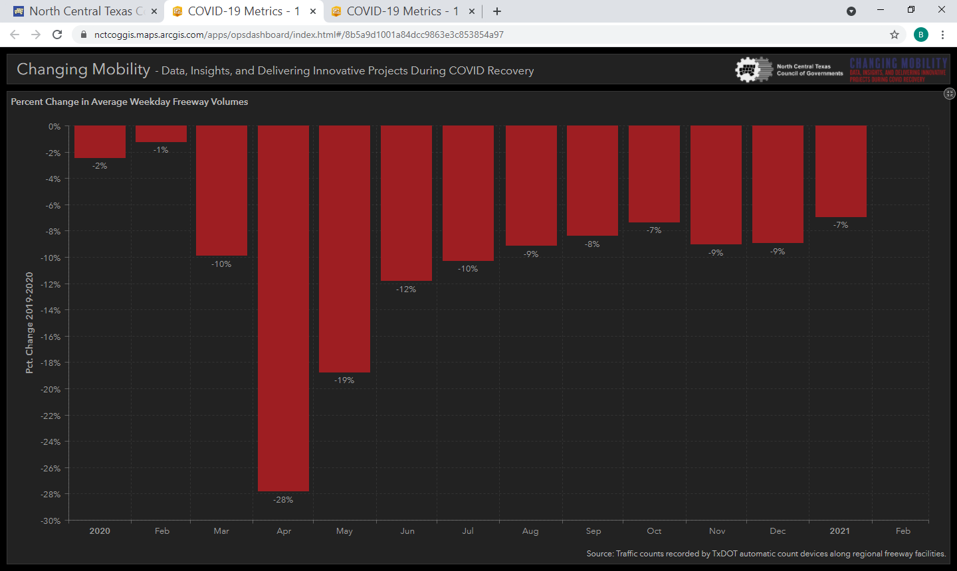
Percent Change in Average Weekday Freeway Volumes

Slide 23
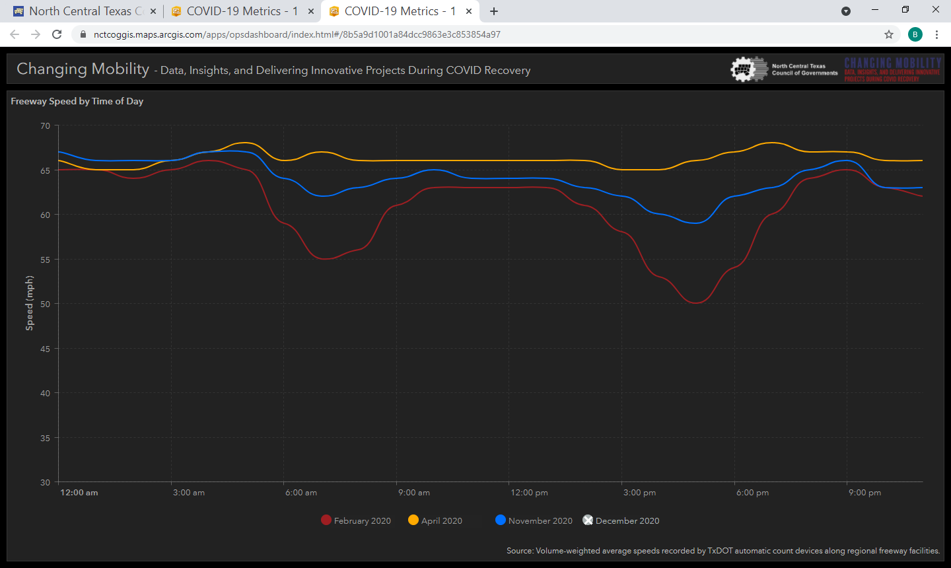
Freeway Speed by Time of Day

Slide 24
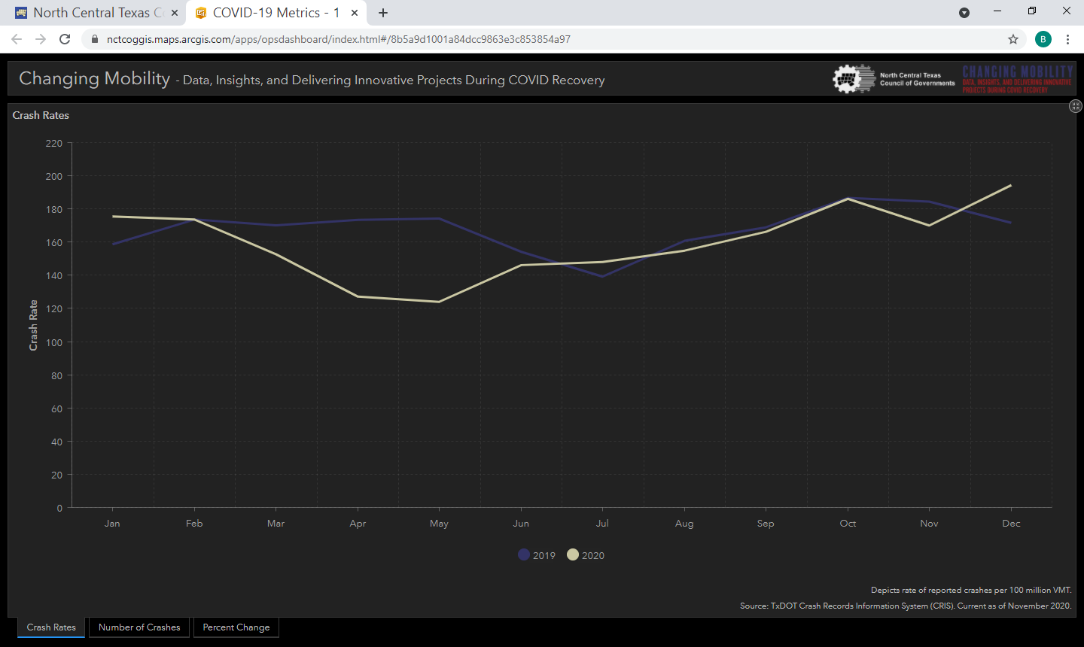
Crash Rates

Slide 25
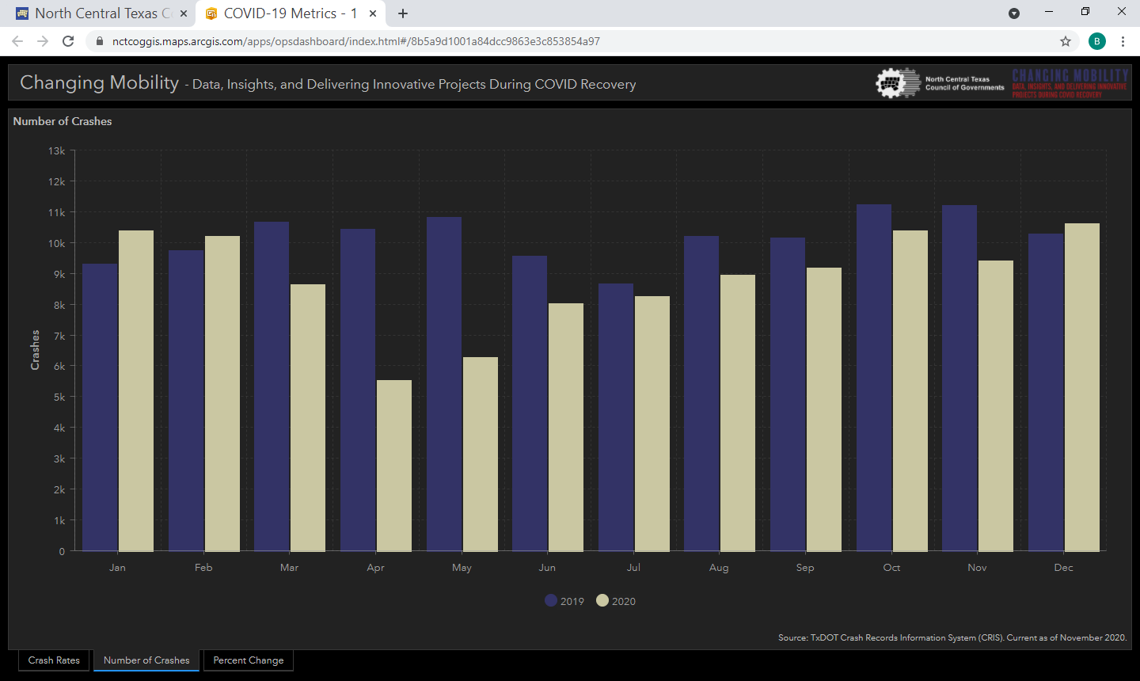
Number of Crashes

Slide 26
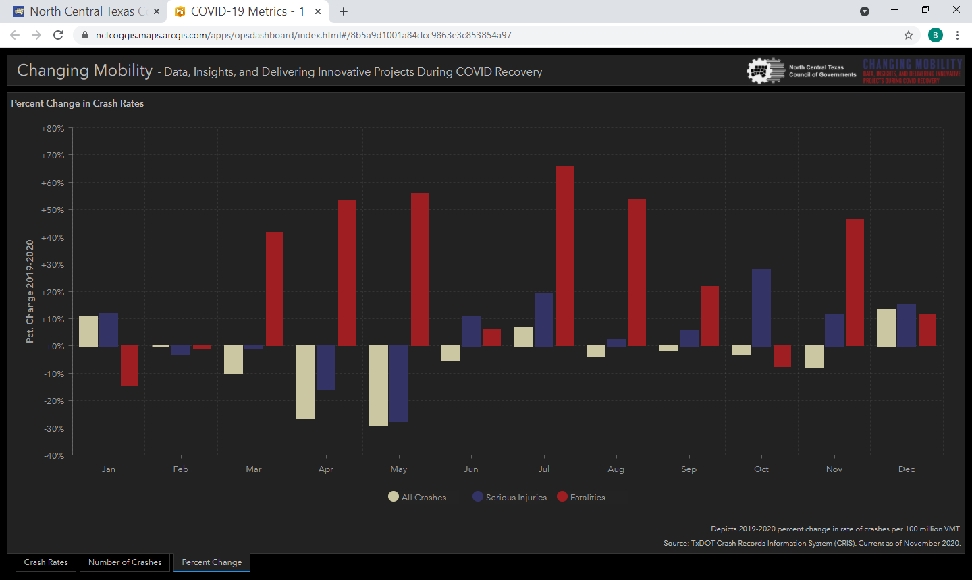
Percent Change in Crash Rates

Slide 27
Performance Measures Timely Service
Keller-Westlake Service Community
NETCOM: Answer 911 in < 10 seconds (Goal 90%) 99%
NETCOM: Answer 911 to Dispatch appropriate service (PD, FD, EMS)
(Goal < 90 seconds) :49 seconds
Patrol Response Time to Priority 1 Call: (Goal <4 min) 3:27 (Drive Time)
Patrol Response Time to All Priority Calls: (Goal <15 min) 11:06
Respect of citizen’s time

Slide 28
Performance Measures Quality of Service - Westlake
Keller-Westlake Police Services Survey Jan/Feb 2020
92.8% Very Professional and Caring; Exceeding Expectations
99% Met or Exceeded Expectations.
93.3% Overall Rating of Excellent
100% of the Westlake respondents stating they feel safe walking alone in the neighborhood or workplace at night.
Consistent Communication - Vital
Westlake Deputy Town Manager Simon
Chief Fortune
Captain Talkington

Slide 29
Staffing
Title/Rank | Authorized
Police Chief | 1
Police Captain | 2
Police Lieutenant | 2
Police Sergeant | 6
Police Corporal | 4
Patrol Officer (LtFT SRO - .75) | 36.75
Subtotal Sworn Personnel | 51.75
Administration | 3
NETCOM Regional Dispatch Center | 22
Records Technicians | 3
Regional Detention Facility | 8
Regional Animal Control | 4
Subtotal Non-Sworn Personnel | 40
Total | 91.75

Slide 30
Demographics – Sworn Personnel 12/31/20
 | Service Population |  | Male Sworn Officers |  | Female Sworn Officers |  | Sworn Officers Total
 | # | % | # | % | # | % | # | %
White Non-Hispanic | 37,692 | 79 | 34 | 70 | 7 | 14 | 41 | 84
Black Non-Hispanic | 890 | 2 | 2 | 4 | 0 | 0 | 2 | 4
Hispanic Latino Any Race | 4796 | 10 | 3 | 6 | 0 | 0 | 3 | 6
Other | 4418 | 9 | 2 | 4 | 1 | 2 | 3 | 6
Total | 47,796 | 100 | 41 | 84 | 8 | 16 | 49 | 100
*As of 12/31/20, prior to Officer Shimanek resigning. Includes Less than Full Time SRO as 1. Service population includes Keller and Westlake 2019 Census Estimates.

Slide 31
2020 Year in Review New Chief & COVID-19
March 9, 2020: Chief Fortune sworn in as new Chief of Police
March 11, 2020: World Health Organization declared the coronavirus, now designated COVID-19, a global pandemic
First Week: President, Texas Governor, Tarrant County Judge, and City of Keller Mayor had issued National Emergency and disaster declarations
First 10 Days: State of Texas was operating under newly required restrictions: ‘social distancing’ & ‘stay at home’ orders
New Protocols - Limit Personal Contact: Personal protective equipment, traffic enforcement, entering residences, phone response vs in-person

Slide 32
2020 Year in Review August 15th Incident - Action Items
Training, Policies & Practices
• Quarterly supervisor meetings (ownership/consistent communication)
• Review and Identify how we train our values:
Purposely train: ‘empathy in action’
Re-emphasize soft skills: de-escalation, communication, working with mental health consumers, persons with intellectual disabilities, etc.
How to incorporate our values/soft skills with each tactic/topic:
Tarrant County College (TCC) – Basic Police Academy
Field Training Program
In-service – Incumbent Officers
Quarterly Firearms & Defensive Tactics Training – Lesson Plans

Slide 33
August 15th Incident - Action Items
Training, Policies & Practices
Current policies
Traffic Only "Class C" arrests: Prohibit, with specific law enforcement exceptions and supervisor approval
Vehicle Inventory: Two (2) officers perform w/officer safety exception
Police Executive Research Forum: 30 Guiding Principles on Use of Force
Implement ‘Critical Decision-Making Model’
Revision to Internal Affairs policy
Discipline Matrix w/Citizen Review (April/May timeline)
Increase supervisory and digital recordings review
Increase in-car, body-worn camera and in-person reviews (3 each per month)

Slide 34
August 15th Incident - Action Items
Transparency, Accountability & Input
Periodic reports to Keller City Council (quarterly vs annual)
Complaints & Response to Resistance
Citizens Police Academy
Racial Profiling Report: Del Carmen Consulting
Texas Racial Profiling Law
Sandra Bland Act
Crime Control Prevention District (CCPD) (2 year terms, no limits)

Slide 35
August 15th Incident - Action Items
Transparency, Accountability & Input
Chief’s Advisory Council (2 year term + 1 year extension)
1st term: 9/1/19 – 8/31/21
Developed selection process for new members
Keller-Westlake Council approval/input (Mayor/Mayor Pro-Tem)
Keller ISD Programs
Police Chief’s Student Forum at Keller High School
Miss Keller – Cops in the Community
Community Safety Education Act
KPD developed a course through our Community Services Officer – COVID

Slide 36
Racial Profiling Report
Del Carmen Consulting
Texas Racial Profiling Law: (enacted 2001/modified 2009) Keller PD collected and reported motor vehicle-related contact data for the purpose of identifying and addressing (if necessary) areas of concern regarding racial profiling practices.
Sandra Bland Act: (enacted 2017) Keller PD collected additional data and provided a more detailed analysis.
All of these requirements have been met by the Keller Police Department
The comprehensive analysis of the data included in this report demonstrates that the Keller Police Department has complied with the Texas Racial Profiling Law and all of its requirements.
Further, the report demonstrates that the police department has incorporated a comprehensive racial profiling policy, currently offers information to the public on how to file a compliment or complaint, commissions quarterly data audits in order to ensure validity and reliability, collects and commissions the analysis of Tier 2 data, and ensures that the practice of racial profiling is not tolerated. (full report available at www.cityofkeller.com/crime)

Slide 37
Racial Profiling Report
2020 Bias Policing Annual Review
Overall motor vehicle stop, citation, warning, search, seizure, arrest, and response to resistance data do not identify trends of bias in race, ethnicity, gender, or age where that data is available.
There were no equipment needs, training needs, or disciplinary issues identified at this time.

Slide 38
2020 Year in Review Regional Partnerships
Continue providing full police services to the Town of Westlake
October 6, 2020: City of Roanoke joined interlocal agreement for combined jail services, animal control and animal shelter services with Keller, Southlake and Colleyville
Continue providing public safety dispatching services to Keller, Southlake and Colleyville for police, fire, EMS and animal control
Continue partnership with the Humane Society of North Texas for animal care and adoption

Slide 39
Questions?
Chief Bradley G. Fortune
Keller Police Department
817-743-4502
bfortune@cityofkeller.com

