Slide 1
Keller Police Department
‘Town of Westlake’
Annual Report 2021
Chief Bradley G. Fortune
March 28, 2022
Excellence • Integrity • Service • Creativity • Communication

Slide 2
Department Mission & Values
The Keller Police Department is a value driven organization committed to excellence and will partner with the community to make Keller a better place to live, visit and conduct business.
E⁴ Core Value System
  Empathy
  Edification
  Enthusiasm
  Excellence

Slide 3
Performance Measures
Crime Rate
Traffic Safety
Timely Service
Quality of Service
We remain committed to provide consistent services to ensure public safety. We will continue proactive patrol efforts, high visibility traffic enforcement, attending community events as well as business and HOA meetings with the various Westlake stakeholders.

Slide 4
Performance Measures
Crime Rate – Westlake
FBI’s Uniform Crime Reporting (UCR):
  Murder, Rape, Robbery, Aggravated Assault, Burglary, Larceny/Theft, Auto Theft, Arson
  3.46 per 1,000 in daytime population (48 Part 1 Crimes)
    6.99% decrease from 2020 – 3.72
  89% - property crimes (2020 – over 72%)
    Larceny/thefts from unsecured vehicles and construction sites
  Crime Prevention Unit (Hide, Lock, Take)
    Citizen Meeting: (November - Fire Station)

Slide 5
Performance Measures
Traffic Safety - Westlake
Enforcement, Education, Partnership
9.88% increase in reportable crashes from 2020 (81) to 2021 (89)
  Pre-Covid: 2019 (94) (2021 a 5.32% decrease from 2019)
15.98% increase in overall crashes from 2020 (219) to 2021 (254)
  Pre-Covid: 2019 (327) (2021 a 22.32% decrease from 2019)
Fatality crashes: 2020 (1) to 2021 (0)
Top Three Factors for Intersection Crashes
  Failed to Yield Right of Way - Stop Sign or Disregard Stop and Go Sign
  Texting while driving, fatigued or asleep
  Unsafe Lane Change
Top Three Locations for Crashes (Same as 2020)
  Trophy Lake and SH 114
  Trophy Club and SH 114
  US 377 and SH 170

Slide 6
Performance Measures
Traffic Safety - Westlake
Keller
2020 Keller: Stops 11959 Citations 5572
2021 Keller: Stops 15743 (31.64% increase) Citations 4792 (13.99% decrease)
30.44% of stops received a citation
10.8% of daytime population (44,320) received a citation
Westlake
2020 Westlake: Stops 7457 Citations 5204
2021 Westlake: Stops 7049 (5.47% decrease) Citations 4427 (14.93% decrease)
62.80% of stops received a citation
32.8% of daytime population (13,500) received a citation

Slide 7
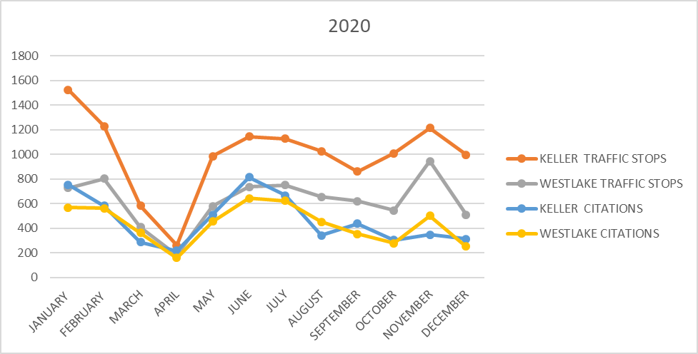
Performance Measures
Traffic Safety - Westlake

Slide 8
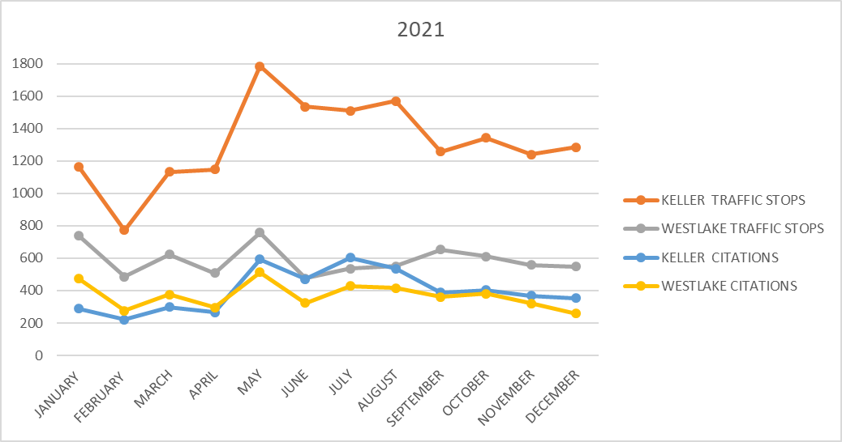
Performance Measures
Traffic Safety - Westlake

Slide 9
North Central Texas Council Of Government (NCTCOG)
Changing Mobility: Data, Insights, and Delivering Innovative Projects
During COVID Recovery (February 2022
https://www.nctcog.org/getmedia/b36f99ab-6a7b-4b4a-a526-26af94ad1937/Item-10_Changing-Mobility-February.pdf.aspx

Slide 10
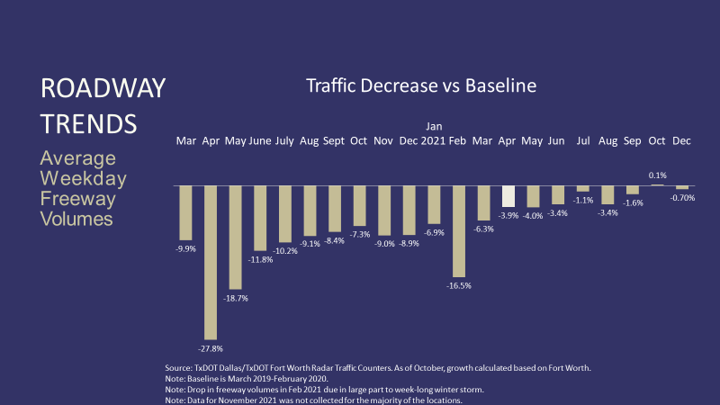
Percent Change in Average Weekday Freeway Volumes

Slide 11
Performance Measures
Timely Service
Keller-Westlake Service Community
NETCOM: Answer 911 in < 10 seconds (Goal 90%) 99%
NETCOM: Answer 911 to Dispatch appropriate service (PD, FD, EMS)
(Goal < 90 seconds) :48 seconds
Patrol Response Time to Priority 1 Call: (Goal <4 min) 3:16 (Drive Time)
Patrol Response Time to All Priority Calls: (Goal <15 min) 11:18
  2022 Goal moved to < 12 min
Respect of citizen’s time

Slide 12
Performance Measures
Quality Service
End of Year – Citizen Survey (Dec 21 – Jan 22)
97% of Keller respondents and 100% of Westlake respondents feel safe to walk alone at night in their neighborhood or workplace.
Speeding and Traffic Violations are the #1 concern in both Keller and Westlake.
Both Keller and Westlake residents would like the Keller Police Department to direct significant effort toward Crime Prevention and Education and specific education on how to decrease the offense of Theft from Vehicles.
98% of the Keller respondents & 100% of the Westlake respondents rated the overall competency as well as the officers/employees’ attitudes and behavior of the KPD as having met or exceeded expectations.
99% of Keller residents and 100% of Westlake residents rated the police department as average, above average, or excellent.

Slide 13
Performance Measures
Quality Service
Supervisor Retreat: October 15, 2021
  Mike Mowery: Servant Leadership
  Fidelity Investments
Neighborhood/New Resident Meetings
Metroport Rotary – Marriott Solana
Westlake Academy
  Student Forum
  Participated in Emergency Preparedness TTX
  Substation: Complete reports, return calls, breaks
Toured Facilities w/Command Staff
  Fidelity Investments
  Deloitte University
  Charles Schwab

Slide 14
Performance Measures
Quality Service
Cost Efficiency:
Price of the police services agreement: $993,553
Total number of Westlake calls for service 15,258
Town of Westlake per call for service: $65.12
City of Keller per call for Service: $95.35

Slide 15
Staffing
Title/Rank | Authorized
Police Chief | 1
Police Captain | 2
Police Lieutenant | 2
Police Sergeant | 6
Police Corporal | 4
Patrol Officer (LtFT SRO - .75) | 36.75
Subtotal Sworn Personnel | 51.75
Administration | 3
NETCOM Regional Dispatch Center | 22
Records Technicians | 3
Regional Detention Facility | 9
Regional Animal Control | 4
Subtotal Non-Sworn Personnel | 41
Total | 92.75

Slide 16
Demographics – Sworn Personnel
 | Service Population |  | Male Sworn Officers |  | Female Sworn Officers |  | Sworn Officers Total
 | # | % | # | % | # | % | # | %
White Non-Hispanic | 37,251 | 79 | 35 | 67 | 8 | 15 | 42 | 81
Black Non-Hispanic | 915 | 2 | 4 | 8 | 1 | 2 | 5 | 9
Hispanic Latino Any Race | 4709 | 9 | 2 | 4 | 0 | 0 | 3 | 6
Other | 4524 | 10 | 1 | 2 | 1 | 2 | 2 | 4
Total | 47,399 | 100 | 42 | 81 | 10 | 19 | 52 | 100

Slide 17
2021 Year in Review
New COVID-19 Variant (Omicron & Delta) – Staffing Challenges
Winter Storm
Hail Storm
Student Forums w/KISD and Westlake Academy
Mental Health Behavioral Intervention team
Texas Police Chief Association - Re-Recognized
Crime Control Prevention District – Election (15 year continuation)
Promoted two (2) Officers to Corporal (Acosta & Telesko)
** February 22 Incident – Life-Saving Award

Slide 18
Accreditation & Recognition
TPCA (Texas Police Chief’s Association)
  May 4-6, 2021 – Onsite
  Reviewed and confirmed compliance with 170 TPCA standards
    Team Leader – Chief Michael Sullivan, Farmersville (TX) PD
    Team Member – Asst. Chief Johnathan Gage, Kilgore (TX) PD
  Re-Recognized May 16, 2021
  Renamed: Law Enforcement Accreditation Program
CALEA (The Commission on Accreditation for Law Enforcement Agencies)
  July 9-17, 2021 – Web-Based File Reviews for Law Enforcement and Communications
    Reviewed and confirmed compliance with approximately ¼ of 458 CALEA standards
      Compliance Service Member – Danny Messimer, CALEA (Ret. Major; Marietta (GA) PD)
  On-Site: March 21-23, 2022

Slide 19
Regional Partnerships
Continue providing full police services to the Town of Westlake
Continue providing public safety dispatching services to Keller/Westlake, Southlake, Colleyville for police, fire and EMS, including Westlake FD/EMS
Continue providing combined jail services, animal control and animal shelter services for Keller/Westlake, Roanoke, Southlake and Colleyville
Continue partnership with Humane Society of North Texas (HSNT) for animal care and adoption
Continuing as a member of North Tarrant Regional (NTR) SWAT Team with Southlake, Colleyville, Roanoke, & Trophy Club
Continuing as a member of the Crash Reconstruction Team with Roanoke, Argyle, Northlake, Bartonville, Southlake, & Watauga

Slide 20
Racial Profiling Report
Del Carmen Consulting
Texas Racial Profiling Law: (2001)(2009) Keller PD collected and reported motor vehicle-related contact data for the purpose of identifying and addressing (if necessary) areas of concern regarding racial profiling practices.
Sandra Bland Act: (2017) Keller PD collected additional data and provided a more detailed analysis.
All of these requirements have been met by the Keller Police Department
The comprehensive analysis of the data included in this report demonstrates that the Keller Police Department has complied with the Texas Racial Profiling Law and all of its requirements. Further, the report demonstrates that the police department has incorporated a comprehensive racial profiling policy, currently offers information to the public on how to file a compliment or complaint, commissions quarterly data audits in order to ensure validity and reliability, collects and commissions the analysis of tier 2 data, and ensures that the practice of racial profiling is not tolerated.

Slide 21
Questions?
Chief Bradley G. Fortune
Keller Police Department
817-743-4502
bfortune@cityofkeller.com

