Slide 1
Keller Police Department ‘Town of Westlake’ Annual Report 2022
Chief Bradley G. Fortune
February 27, 2023

Slide 2
Department Mission & Values
The Keller Police Department is a value driven organization committed to excellence and will partner with the community to make Keller a better place to live, visit and conduct business.
E⁴ Core Value System
Empathy
Edification
Enthusiasm
Excellence

Slide 3
Performance Measures
Crime Rate
Traffic Safety
Timely Service
Quality of Service
We remain committed to provide consistent services to ensure public safety. We will continue proactive patrol efforts, high visibility traffic enforcement,
attending community events as well as business and HOA meetings
with the various Westlake stakeholders.

Slide 4
Performance Measures Crime Rate
FBI’s Uniform Crime Reporting (UCR)
Murder, Rape, Robbery, Aggravated Assault, Burglary, Larceny/Theft, Auto Theft, Arson
34 Part 1 Crimes
National Incident-Based Reporting System (NIBRS):
1.98 per 1,000 in daytime population (17,169*)
(*Daytime population per Director of Planning & Development)
14% decrease from 2021 – 2.31
27% decrease from 2020 – 2.73

Slide 5
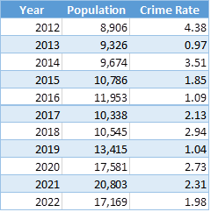
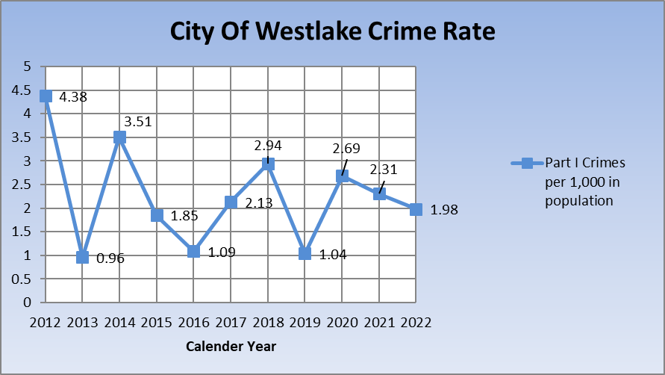
Crime Rate

Slide 6
2021 Comparison
Dallas - 42.26
Haltom City - 32.20; Ft. Worth - 31.80; Arlington - 31.20
N. Richland Hills - 23.61
Plano - 17.90
Roanoke - 13.58
Southlake - 9.48
Keller - 6.29
Trophy Club - 4.69; Colleyille - 4.53
Westlake – 2.31

Slide 7
Crime Trends
2022:
DWI Arrests = 47 (36 in 2021) 31% increase
Narcotic Arrests = 43 (35 in 2021) 23% increase
Larceny/thefts
Construction sites
Unsecured vehicles
CVS
Crime Prevention Unit (Hide, Lock, Take)
94.1% - property crimes (Burglary & Larceny/Theft)
29 of 34 Part 1 Crimes - Larceny/Theft

Slide 8
Performance Measures Traffic Safety
Enforcement, Education, Partnership
6% increase in reportable crashes from 2021 (89) to 2022 (95)
22% increase in overall crashes from 2021 (254) to 2022 (310)
Fatality crashes: 2021 (0) to 2022 (1)
Top Three Factors for Intersection Crashes
Failed to Yield Right of Way - Stop Sign or Disregard Stop and Go Sign
Texting while driving, fatigued or asleep
Failed to control speed
Top Three Locations for Crashes
Davis and SH 114
Trophy Lake and SH 114
Roanoke Road and SH 170

Slide 9
Performance Measures Timely Service
Westlake:
NETCOM: Answer 911 in < 10 seconds (Goal 90%) 99%
NETCOM: Answer 911 to Dispatch appropriate service (PD, FD, EMS)
(Goal < 90 seconds) :41 seconds (Total: Keller, Westlake, Southlake, Colleyville)
Patrol Response Time to Priority 1 Call: (Goal <5 min) 4:14 (drive time); 4:55 (911 call
to arrival)
Fastest: 1:15 (:20 drive time)
Slowest: 13:56 (medical, conscious & breathing – no code)
Patrol Response Time to All Priority Calls: (Goal <12 min) 10:15
Respect of citizen’s time

Slide 10
Performance Measures Quality Service
Westlake Resident Survey 2022
98% of respondents indicated an ‘overall feeling of safety.’ Texas average: 61% U.S. average: 68%.
99% of respondents felt ‘low crime rates/quality of public safety’ was ‘extremely important,’ ‘very important,’ or ‘important’ of a reason to move to Westlake.
89% overall satisfaction with the ‘quality of public safety services.’ Texas average: 53% U.S. average: 67%.
73% indicated ‘quality of public safety services’ as ‘most important’ in the major categories of town services.
Keller-Westlake Police Services Survey Jan 2022
100% of the Westlake respondents stated they feel safe walking alone in the neighborhood or workplace at night.
100% Met or Exceeded Expectations (overall competency of Keller PD employees)
93.3% Overall Rating of Excellent
92.8% Very Professional and Caring; Exceeding Expectations

Slide 11
Performance Measures Quality Service
Cost Efficiency:
Price of the police services agreement: $1,091,192
Total number of Westlake calls for service: 16,830
Town of Westlake per call for service: $64.84
City of Keller per call for Service: $154.41

Slide 12
Staffing
Title/Rank | Authorized
Police Chief | 1
Police Captain | 2
Police Lieutenant | 2
Police Sergeant | 6
Police Corporal | 4
Patrol Officer | 40
Subtotal Sworn Personnel | 55
Administration | 3
NETCOM Regional Dispatch Center | 22
Records Technicians | 3
Regional Detention Facility | 9
Regional Animal Control | 4
Subtotal Non-Sworn Personnel | 41
Total | 96

Slide 13
Demographics – Sworn Personnel
 | Service Population |  | Male Sworn Officers |  | Female Sworn Officers |  | Sworn Officers Total
 | # | % | # | % | # | % | # | %
White Non-Hispanic | 1561 | 86 | 35 | 68 | 8 | 16 | 43 | 84
Black Non-Hispanic | 18 | 1 | 4 | 8 | 0 | 0 | 4 | 8
Hispanic Latino Any Race | 36 | 2 | 2 | 4 | 0 | 0 | 2 | 4
Other | 200 | 11 | 1 | 2 | 1 | 2 | 2 | 4
Total | 1815* | 100 | 42 | 82 | 9 | 18 | 51 | 100
*Night time population

Slide 14
2022 Year in Review
Colleyville Hostage Incident – Congregation Beth Israel (NETCOM & NTR SWAT)
Winter Weather Event
CAD/RMS Central Square Go-Live
CALEA Law Enforcement and Communications Re-Accreditation
Added School Resource Officer (SRO) to Westlake Academy
Supervisor Retreat: October 21, 2022 – Marcel Brunel (Fidelity Investments)
Taser Program fully implemented
Implemented ‘CID VIPS Assist program’
Upgraded Access Control & Refinished Floors in Jail, Animal Control & Adoption

Slide 15
2022 Year in Review Re-Accreditation
The Keller Police Department first earned Advanced Law Enforcement Accreditation in 2006.
March:
Virtually hosted CALEA Assessors
July: Chicago, Illinois Conference:
Keller (TX) Police Dept – Advanced Law Enforcement Accreditation (459 Standards, 6th Award)
Keller (TX) Police Communications – Communications Accreditation (207 Standards, 2nd Award)
The accreditation processes are funded by the Keller Crime Control and Prevention District (CCPD) sales tax.

Slide 16
2022 Year in Review Regional Partnerships
Continue providing full police services to the Town of Westlake
Continue providing public safety dispatching services to Keller/Westlake, Southlake, Colleyville for police, fire and EMS, including Westlake FD/EMS
Continue providing combined jail services, animal control and animal shelter services for Keller/Westlake, Roanoke, Southlake and Colleyville
Continue partnership with Humane Society of North Texas (HSNT) for animal care and adoption
Continuing as a member of North Tarrant Regional (NTR) SWAT Team with Southlake, Colleyville, Roanoke, & Trophy Club
Continuing as a member of the Crash Reconstruction Team with Roanoke, Argyle, Northlake, Bartonville, Southlake, & Watauga

Slide 17
Racial Profiling Report
Del Carmen Consulting
Texas Racial Profiling Law: (2001)(2009) Keller PD collected and reported motor vehicle-related contact data for the purpose of identifying and addressing (if necessary) areas of concern regarding racial profiling practices.
Sandra Bland Act: (2017) Keller PD collected additional data and provided a more detailed analysis.
All of these requirements have been met by the Keller Police Department
The report demonstrates that the police department has incorporated a comprehensive
racial profiling policy, currently offers information to the public on how to file a
compliment or complaint, commissions quarterly data audits in order to ensure
validity and reliability, collects and commissions the analysis of tier 2 data,
and ensures that the practice of racial profiling is not tolerated.

Slide 18
2022 Year in Review Awards
Certificate of Merit: Officer Danny Coulson
Chief’s Letter of Commendation: Accreditation Mgr Amanda Baker-Potter
Life Saving: NETCOM Dispatch Supervisor Rachel Hawk
Life Saving: NETCOM Dispatcher Kellie Neal
Life Saving: NETCOM Dispatcher Michelle Eckley
Life Saving: Detective Jonathan Dickerson
Life Saving: Officer Kirsten Furin

Slide 19
2022 Year in Review Career Development/Leadership Training
Tarrant County College – Basic Peace Officer Academy
Carson Craven
Austin Forest
Erin McGuire
Jakob Hall
Andrew Tarnowski
Robert Vilbig
Texas Police Chiefs Association (TPCA) Developing Leaders
Sergeant Gerade Telesko
ILEA School of Police Supervision
Sergeant Robert Carte
Sergeant Robert Carothers
ILEA School of Executive Leadership
Lieutenant Craig Berry
PERF Senior Management Institute for Police (SMIP) & FBI National Academy
Captain Chad Allen

Slide 20
2022 Year in Review Promotions
Detention
Detention Manager Charlotte Fresh (October)
Dispatch
Supervisor Cassidi Parrish (August)
Supervisor Rachel Hawk (November)
NETCOM Assistant Manager Jessica Schreiber (October)
Police
Corporal Mike Riehle (May)
Corporal Jorge Torres (September)
Sergeant Gerade Telesko (April)
Lieutenant Jay Yates (April)
Captain Jared Lemoine (April)

Slide 21
2022 Year in Review Retirements
Animal Control
Michelle Watson (December) (19 Years)
Building Maintenance
Jose Rodriguez (July) (14 Years)
Dispatch
Kari Lemoine (July) (23 Years)
Jennifer Martinez (October) (22 Years)
Police
Wes Horton (May) (19 Years)
Tracy Talkington (April) (32 Years)

Slide 22
Questions?
Chief Bradley G. Fortune
Keller Police Department
817-743-4502
bfortune@cityofkeller.com

